Slide 1
General Education Redesign Task Force
GERT-Force?
September 13, 2018

Slide 2
Today...
Recent History of Gen Ed at McNeese
Overview of Gen Ed Requirements
Presentation by Dr. Angelique Ogea
Rough Timeline for this Committee
How are we going to meet our December goal?

Slide 3
History
2007
  McNeese put on SACSCOC monitoring for general education
2012
  Fifth-year report submitted.
  BOR changed the requirements from 12 SLOs to 6 disciplinary areas.
  Dr. Dvorske and a committee created a student learning outcome for each disciplinary area.
  Certain high enrollment courses in each area were tagged for assessment.
  The process was left to run its course, but with few governing documents and little data collection or analysis.

Slide 4
Current McNeese General Education SLOs
1) Communicate effectively in written English. (Area A – English Composition)
2) Apply mathematical reasoning and analytical skills to solve problems. (Area B – Mathematics/Analytical Reasoning)
3) Demonstrate knowledge of scientific concepts. (Area C – Natural Sciences)
4) Demonstrate abstract reasoning and critical thinking. (Area D – Humanities)
5) Develop the ability to recognize fine and performing arts as expressions of human experience and to make informed judgments about them. (Area E – Fine Arts)
6) Learn independently by applying concepts from social and behavioral sciences to a variety of situations. (Area F – Social/Behavioral Sciences)

Slide 5
History
2015
Preparation for SACSCOC reaffirmation begins, and IRE staff changes.
Re-convening of the General Education Assessment Committee, creation of the General Education Assessment Plan, and compilation of existing data into a report.
2017
Reaffirmation with general education approval.

Slide 6
What exactly do we HAVE to do?
(Section 8 – Student Achievement, 8.2 Student Outcomes)
SACSCOC Standard 8.2.b – The institution identifies expected outcomes, assesses the extent to which it achieves these outcomes, and provides evidence of seeking improvement based on analysis of the results in the areas below:
  b. Student learning outcomes for collegiate-level general education competencies of its undergraduate degree programs.

Slide 7
What exactly do we HAVE to do?
(Section 9 – Educational Program Structure and Content)
SACSCOC Standard 9.3 – The institution requires the successful completion of a general education component at the undergraduate level that
  is based on a coherent rationale.
  is a substantial component of each undergraduate degree program. For degree completion in associate programs, the component constitutes a minimum of 15 semester hours or the equivalent; for baccalaureate programs, a minimum of 30 semester hours or the equivalent.
  ensures breadth of knowledge. These credit hours include at least one course from each of the following areas: humanities/fine arts, social/behavioral sciences, and natural sciences/mathematics. These courses do no narrowly focus on those skills, techniques, and procedures specific to a particular occupation or profession.

Slide 8
What exactly do we HAVE to do?
Louisiana Board of Regents Academic Affairs Policy 2.16:
English Composition
Mathematics/Analytical Reasoning
Natural Sciences
Humanities
Social/Behavioral Sciences
Fine Arts
...and the chart.

Slide 9
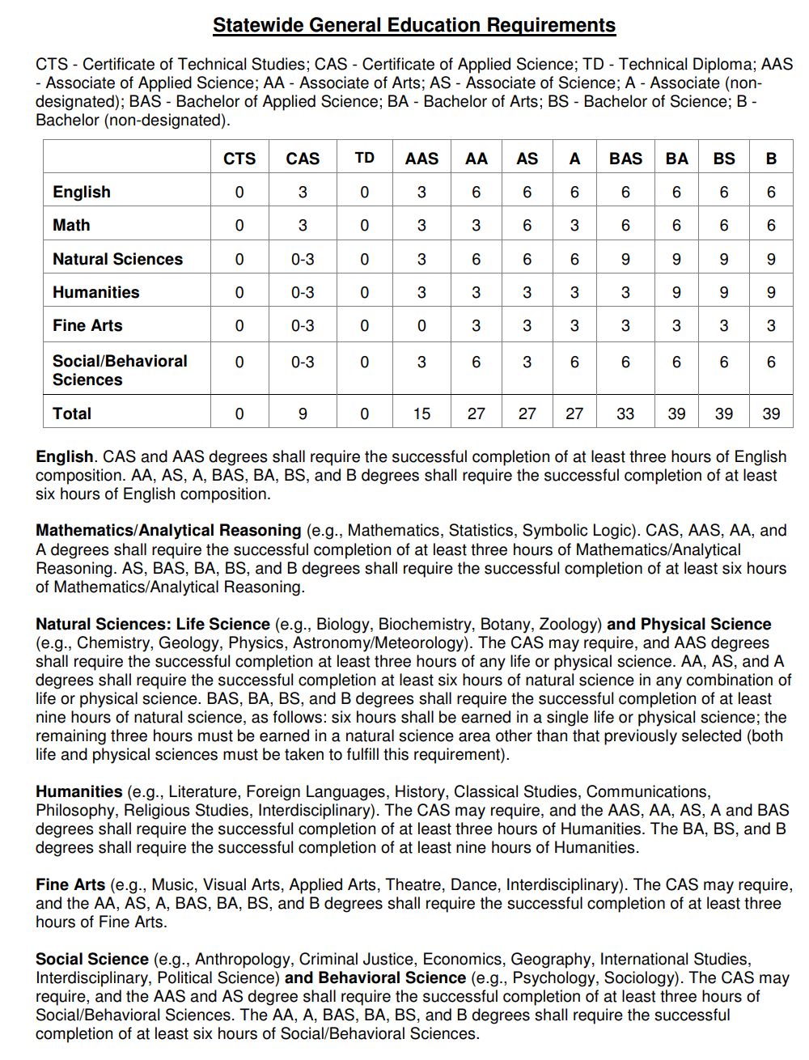

Slide 10
Current General Education Plan and Report
Brief discussion of plan content: GEAC, approval processes and policies, assessment processes and policies, rubrics.
Brief discussion of report content: assessment participation, analyses and actions, data.
Questions?
Compare our general education core curriculum to the models provided. How are they different? What makes ours better or worse than the others?

Slide 11
Dr. Angel Ogea's Presentation

Slide 12
Task Force Charge and Plan
The Task Force will develop general education student learning outcomes.
  Engage the campus in a discussion about important graduate attributes.
  Attend professional development about curriculum and instruction.
The University will redesign general education core courses and capstone courses to align with the new student learning outcomes.
  Arrange for the best professors to teach core courses with VL/instructor support.
  Provide faculty development in course and assignment design.
  Seek and resolve implementation challenges, such as those involving transfer credits and the workload on staff.
  Develop an efficient assessment process.
The University will design co-curricular experiences for the first year that align with the new student learning outcomes.
  Create experiences through the Division of Student Affairs to enhance student learning.
  Execute the objectives of the QEP and seek other methods to improve advising.

Slide 13
First Year Experience
Which courses should students take their first year? How can we make a simple adjustment in the curriculum to begin the refining process?
What co-curricular activities can we add to the gen ed?
What would a sub-committee look like for this facet of our charge?

Slide 14
Rough Timeline
December 2018 – Approval of new student learning outcomes.
February 2019 – AAC&U General Education Conference.
Spring 2019 – Rubric development for new SLOs. How will we assess our new SLOs? Portfolios? Artifacts? We need to design a process for institutional assessment and have it in place BEFORE we implement.
Summer 2019 – Course and Syllabi analysis. Which courses/assignments need redevelopment? Which courses need to embed SLOs? Will we need to implement the redesign in phases?
Spring and Summer 2019 – Co-curricular FYE development. Will we need a sub-committee at this point? Who should serve?

Slide 15
Rough Timeline
Fall 2019 – FYE Co-curricular pilot?
Fall and Spring 2019 – Targeted course and assignment design
Fall and Spring 2019 – Assessment and approval process development
Spring 2019, Summer 2019 – Staff Implements new courses for Fall 2020?

Slide 16
Let's get organized.
How will we keep our records?
Meeting minutes, presentation slides, handouts, etc.
How will we communicate our progress to the campus?

Slide 17
Communication and Transparency
How will we share our progress with the campus?
Importance of careful thinking, open discussions, and consideration of diverse points of view.
Policy creation – clear and efficient policies and procedures. Unambiguous requirements for course approval.

Slide 18
We need input from the following:
Deans and department heads
Faculty senate
Library
All academic and student services departments
Community stakeholders, who are these people? What can we ask them that was not covered in the QEP?

Slide 19
We need a plan for SLO development.
How will we develop our SLOs?
How will we engage stakeholders?
What data/information/knowledge/wisdom do we need?
Goal of December approval.
AAC&U General Education Conference in February to begin learning about implementation.

