Slide 1
CAEP
Standard 4
McNeese State University
Spring 2019
CAEP Update Presentation
All data referenced within this PowerPoint is located at the following URL:
https://www.mcneese.edu/stpes/assessment_annual_reports

Slide 2

InTASC Standards
  The Learner and Learning
    Standard 1-
    Learner Development
    Standard 2-
    Learning Differences
    Standard 3-
    Learning Environments
  Content Knowledge
    Standard 4-
    Content Knowledge
    Standard 5-
    Application of Content
  Instructional Practice
    Standard 6-
    Assessment
    Standard 7-
    Planning for Instruction
    Standard 8-
    Instructional Strategies
  Professional Responsibility
    Standard 9-
    Professional Learning and Ethical Practice
    Standard 10-
    Leadership and Collaboration

Slide 3
Standard 4
The provider demonstrates the impact of its completers on P-12 student learning and development, classroom instruction, and schools, and the satisfaction of its completers with the relevance and effectiveness of their preparation.

Slide 4
8 Annual Reporting Measure
Program Impact:
  P-12 student learning/
  development
  Observations of teaching effectiveness
  Employer satisfaction
  Completer persistence
Program Outcome and Consumer Information:
  Completer or graduation rates
  Licensure rate
  Employment rate
  Consumer information, including students loan default rate

Slide 5
Louisiana Department of Education Expectations
Highly Effective:
4.0-3.5
Effective: Proficient:
3.49-2.5
Effective: Emerging:
2.49-1.5
Ineffective:
1.49-1.0
Notes:
MSU FEE is aligned with Louisiana Compass Evaluation except for the addition of two sections: extra Classroom Management and Professional Dispositions. The LDoE has a set benchmark of 1.5 or higher for employed educators.

Slide 6
2018 Louisiana Fact Book and
Data Dash Boards: Undergraduate
Year | Mean Number | Ineffective | Effective: Emerging | Effective: Proficient | Highly Effective
Compass Student Growth (SLT/VAM) (CAEP 4.1)
2016 | 3.4 (n=446) | 3% | 7% | 28% | 63%
2017 | 3.4 (n=422) | 1% | 10% | 23% | 66%
2018 | 3.4 (n=360) | 1% | 10% | 19% | 70%
Compass Professional Practice (Observation Evaluations) (CAEP 4.2)
2016 | 3.2 (n=446) | 1% | 8% | 62% | 30%
2017 | 3.2 (n=422) | 1% | 7% | 55% | 37%
2018 | 3.3 (n=360) | 1% | 6% | 48% | 45%
Compass Final Evaluation (Average of two categories)
2016 | 3.3 (n=446) | 3% | 6% | 51% | 41%
2017 | 3.4 (n=422) | 2% | 7% | 45% | 46%
2018 | 3.4 (n=360) | 1% | 7% | 38% | 54%
Notes:
Data indicate that MSU EPP undergraduate completers are having a positive impact on P-12 learning and development (CAEP 4.1) and have strong instructional practices leading to high levels of teaching effectiveness (CAEP 4.2).
Using information reported by the LBoR Data Dashboards, MSU undergraduate completers with teaching experience of 1 and 2 years, have a steady mean score of 3.4 for CAEP 4.1 which is at the high end of the Effective: Proficient range (2.5-3.49) over the last three reporting years with a state benchmark of 1.5. Also noted is that 89-91% of our undergraduate candidates have scored at or above the Effective: Emerging range (2.5 or above) during the 2016-2018 reporting dates. Using data reported within the LBoR Fact Book, MSU completers ranked second out of the 14 Louisiana public universities in which data is provided with a mean score of 3.4 for 2018 in Compass student growth (SLT/VAM) (CAEP 4.1). Growth of 7% over the last three years for completers scoring within the Highly Effective range for CAEP 4.1 is noted as a positive trend.
Using information reported by the LBoR Data Dashboards, MSU undergraduate completers with teaching experience of 1 and 2 years, have a mean score of 3.2-3.3 for CAEP 4.2 which falls within the range of Effective: Proficient (2.5-3.49) over the last three reporting years with a state benchmark of 1.5. Also noted is that 92-93% of our undergraduate candidates have scored at or above the Effective: Emerging range (2.5 or above) during the 2016-2018 reporting dates. Using data reported within the LBoR Fact Book, MSU completers ranked first out of the 14 Louisiana public universities in which data is provided with a mean score of 3.3 for 2018 in Compass professional practice (CAEP 4.2). Growth of 15% over the last three years for completers scoring within the Highly Effective range for CAEP standard 4.2 measures is noted as a positive trend.
Using information reported by the LBoR Data Dashboards, MSU undergraduate completers with teaching experience of 1 and 2 years, have a combined mean score (3.3-3.4) for CAEP measures 4.1 and 4.2 at the high end of the Effective: Proficient over the last three reporting years with a state benchmark of 1.5. Also noted is 91-92% of our undergraduate candidates had a combined mean score at or above the Effective: Emerging range (2.5 or above) during the 2016-2018 reporting dates. Using data reported within the LBoR Fact Book, MSU undergraduate completers ranked first out of the 14 Louisiana public universities in which data is provided with a mean score of 3.4 for 2018 in Compass Final Evaluation Scores (combined 4.1 and 4.2 measures). Growth of 13% when combining CAEP 4.1 and 4.2 measures in the Highly Effective range are noted as positive trends.
Data for the last two reporting cycles (2017-2018) have remained steady for the number of undergraduate candidates scoring in the Ineffective (1.0-1.49) and Effective: Emerging (1.5-2.49) ranges for all both CAEP impact measures (4.1 and 4.2).

Slide 7
2018 Louisiana Fact Book and
Data Dash Boards:
Master of Arts in Teaching (MAT)
Year | Mean Number | Ineffective | Effective: Emerging | Effective: Proficient | Highly Effective
Compass Student Growth (SLT/VAM) (CAEP 4.1)
2016 | 3.4 (n=179) | 3% | 6% | 27% | 64%
2017 | 3.5 (n=120) | 1% | 6% | 22% | 72%
2018 | 3.6 (n=78) | 1% | 8% | 15% | 76%
Compass Professional Practice (Observation Evaluations) (CAEP 4.2)
2016 | 3.3 (n=179) | 0% | 7% | 51% | 42%
2017 | 3.2 (n=120) | 0% | 8% | 44% | 48%
2018 | 3.4 (n=78) | 0% | 6% | 37% | 56%
Compass Final Evaluation (Average of two categories)
2016 | 3.4 (n=179) | 3% | 3% | 49% | 45%
2017 | 3.5 (n=120) | 1% | 3% | 43% | 53%
2018 | 3.6 (n=78) | 1% | 3% | 35% | 62%
Notes:
Data indicate that MSU EPP MAT completers are having a positive impact on P-12 learning and development (CAEP 4.1) and have strong instructional practices leading to high levels of teaching effectiveness (CAEP 4.2).
Using information reported by the LBoR Data Dashboards, MSU MAT completers with teaching experience of 1 and 2 years, have an increasing mean score from 3.4 to 3.6 for CAEP 4.1 which falls in the high end of the Effective: Proficient category (2.5-3.49) and within the Highly Effective range (3.5-4.0) over the last three reporting years with a state benchmark of 1.5. Also noted is that 91-94% of our MAT candidates have scored at or above the Effective: Emerging range (2.5 or above) during the 2016-2018 reporting dates. Using data reported within the LBoR Fact Book, MSU MAT completers ranked first out of the 9 Louisiana public universities in which data is provided with a mean score of 3.6 for 2018 in Compass student growth (SLT/VAM) (CAEP 4.1). Growth of 12% over the last three years for completers scoring within the Highly Effective range for CAEP 4.1 is noted as a positive trend.
Using information reported by the LBoR Data Dashboards, MSU MAT completers with teaching experience of 1 and 2 years, have a mean score of 3.2-3.4 for CAEP 4.2 which falls within the range of Effective: Proficient (2.5-3.49) over the last three reporting years with a state benchmark of 1.5. Also noted is that 92-93% of our MAT candidates have scored at or above the Effective: Emerging range (2.5 or above) during the 2016-2018 reporting dates. Using data reported within the LBoR Fact Book, MSU completers ranked first out of the 9 Louisiana public universities in which data is provided with a mean score of 3.4 for 2018 in Compass professional practice (CAEP 4.2). Growth of 14% over the last three years for completers scoring within the Highly Effective range for CAEP standard 4.2 measures is noted as a positive trend.
Using information reported by the LBoR Data Dashboards, MSU MAT completers with teaching experience of 1 and 2 years, have a combined mean score (3.4-3.6) for CAEP measures 4.1 and 4.2 at the high end of the Effective: Proficient over the last three reporting years with a state benchmark of 1.5. Also noted is 94-97% of our MAT candidates had a combined mean score at or above the Effective: Emerging range (2.5 or above) during the 2016-2018 reporting dates. Using data reported within the LBoR Fact Book, MSU MAT completers ranked first out of the 9 Louisiana public universities in which data is provided with a mean score of 3.6 for 2018 in Compass Final Evaluation Scores (combined CAEP 4.1 and 4.2 measures). Growth of 17% when combining CAEP 4.1 and 4.2 measures in the Highly Effective range are noted as positive trends.
Data for the last two reporting cycles (2017-2018) have remained steady for the number of MAT candidates scoring in the Ineffective (1.0-1.49) and Effective: Emerging (1.5-2.49) ranges for all both CAEP impact measures (4.1 and 4.2).

Slide 8
2018 Louisiana Fact Book and
Data Dash Boards:
Alternative Certification (PBC)
Year | Mean Number | Ineffective | Effective: Emerging | Effective: Proficient | Highly Effective
Compass Student Growth (SLT/VAM) (CAEP 4.1)
2016 | 3.4 (n=105) | 1% | 10% | 26% | 64%
2017 | 3.5 (n=84) | 0% | 6% | 29% | 66%
2018 | 3.6 (n=80) | 0% | 4% | 25% | 71%
Compass Professional Practice (Observation Evaluations) (CAEP 4.2)
2016 | 3.3 (n=105) | 0% | 6% | 50% | 45%
2017 | 3.3 (n=84) | 0% | 4% | 49% | 48%
2018 | 3.4 (n=80) | 0% | 3% | 45% | 53%
Compass Final Evaluation (Average of two categories)
2016 | 3.4 (n=105) | 1% | 5% | 45% | 50%
2017 | 3.5 (n=84) | 0% | 5% | 42% | 54%
2018 | 3.6 (n=80) | 0% | 3% | 38% | 60%
Notes:
Data indicate that MSU EPP PBC completers are having a positive impact on P-12 learning and development (CAEP 4.1) and have strong instructional practices leading to high levels of teaching effectiveness (CAEP 4.2).
Using information reported by the LBoR Data Dashboards, MSU PBC completers with teaching experience of 1 and 2 years, have an increasing mean score from 3.4 to 3.6 for CAEP 4.1 which falls in the high end of the Effective: Proficient category (2.5-3.49) and within the Highly Effective range (3.5-4.0) over the last three reporting years with a state benchmark of 1.5. Also noted is that 90-96% of our PBC candidates have scored at or above the Effective: Emerging range (2.5 or above) during the 2016-2018 reporting dates. Using data reported within the LBoR Fact Book, MSU PBC completers ranked second out of the 11 Louisiana public universities in which data is provided with a mean score of 3.6 for 2018 in Compass student growth (SLT/VAM) (CAEP 4.1). Growth of 7% over the last three years for completers scoring within the Highly Effective range for CAEP 4.1 is noted as a positive trend.
Using information reported by the LBoR Data Dashboards, MSU PBC completers with teaching experience of 1 and 2 years, have a mean score of 3.3-3.4 for CAEP 4.2 which falls within the range of Effective: Proficient (2.5-3.49) over the last three reporting years with a state benchmark of 1.5. Also noted is that 95-98% of our PBC candidates have scored at or above the Effective: Emerging range (2.5 or above) during the 2016-2018 reporting dates. Using data reported within the LBoR Fact Book, MSU PBC completers ranked second out of the 11 Louisiana public universities in which data is provided with a mean score of 3.4 for 2018 in Compass professional practice (CAEP 4.2). Growth of 8% over the last three years for completers scoring within the Highly Effective range for CAEP standard 4.2 measures is noted as a positive trend.
Using information reported by the LBoR Data Dashboards, MSU PBC completers with teaching experience of 1 and 2 years, have a combined mean score (3.4-3.6) for CAEP measures 4.1 and 4.2 at the high end of the Effective: Proficient over the last three reporting years with a state benchmark of 1.5. Also noted is 95-98% of our PBC candidates had a combined mean score at or above the Effective: Emerging range (2.5 or above) during the 2016-2018 reporting dates. Using data reported within the LBoR Fact Book, MSU completers ranked first out of the 11 Louisiana public universities in which data is provided with a mean score of 3.6 for 2018 in Compass Final Evaluation Scores (combined CAEP 4.1 and 4.2 measures). Growth of 10% when combining CAEP 4.1 and 4.2 measures in the Highly Effective range are noted as positive trends.
Data for the last two reporting cycles (2017-2018) have remained steady for the number of PBC candidates scoring in the Ineffective (1.0-1.49) and Effective: Emerging (1.5-2.49) ranges for all both CAEP impact measures (4.1 and 4.2).

Slide 9
Program Comparison
2018 Factbook and Data Dashboard
Compass Final Evaluation
(combined CAEP 4.1 and 4.2)
Program | Mean number | Ineffective | Effective: Emerging | Effective: Proficient | Highly Effective
Undergraduate | 3.4 (n=360) | 1% | 7% | 38% | 54%
MAT | 3.6 (n=78) | 1% | 3% | 35% | 62%
PBC | 3.6 (n=80) | 0% | 3% | 38% | 60%

Slide 10
Completer Data Conclusions
(combined CAEP 4.1 and 4.2)
Undergraduate, MAT, and PBC completers teaching in their first or second year in the 2015-2016 academic year had mean scores of Effective Proficient to Highly Effective (m=3.4-3.6) in all three categories of Student Growth, Professional Practice, and Final Evaluations.
When combining all 4.1 and 4.2 data found within the LBoR Factbook and Data Dashboards and then comparing all three initial-certification program types, the PBC program has the highest percentage of completers scoring at the Effective: Proficient and Highly Effective range at 97%, followed by MAT program at 96%, and undergraduate program at 92%.

Slide 11
Program Comparison
2018 Factbook and Data Dashboard
Compass Student Growth (SLT/VAM)
CAEP 4.1
Program | Mean number | Ineffective | Effective: Emerging | Effective: Proficient | Highly Effective
Undergraduate | 3.4 (n=360) | 1% | 10% | 19% | 70%
MAT | 3.6 (n=78) | 1% | 8% | 15% | 76%
PBC | 3.6 (n=80) | 0% | 4% | 25% | 71%
Notes:
Program completers teaching in Grades 4-8 in Math, Science, Social Studies, and ELA have a combined mean score for Student Learning Targets (SLT) and Value-Added Model (VAM) that show most of our completers score in the Effective Proficient and Highly effective rage with high mean scores between 3.4-3.6.
When examining data specific to student growth in these particular content areas and grade levels, the following is an analysis of program completers’ data specific to VAM scores only. These scores are only calculated if our program has 25 or more completers within the grade level and content area.

Slide 12
Student Growth (VAM)
Disaggregation by Content Area: Undergraduate
Year | number | Ineffective | Effective: Emerging | Effective: Proficient | Highly Effective
Math
2016 | 37 | 41% | 35% | 19% | 5%
2017 | 11 | 64% | 18% | 0% | 18%
2018 | 14 | 50% | 29% | 7% | 14%
Science
2016 | 27 | 15% | 48% | 33% | 4%
2017 | 19 | 21% | 21% | 47% | 11%
2018 | 17 | 12% | 47% | 29% | 12%
Social Studies
2016 | 35 | 9% | 51% | 29% | 11%
2017 | -- | -- | -- | -- | --
2018 | -- | -- | -- | -- | --
English Language Arts
2016 | 45 | 27% | 42% | 27% | 4%
2017 | 11 | 21% | 26% | 32% | 21%
2018 | 22 | 18% | 32% | 32% | 18%
Notes:
Impact on P-12 Learning and Development (CAEP 4.1) using Value-Added Model (VAM) Data Only
Program completers teaching in Grades 4-8 an in Math, Science, Social Studies, and ELA have a combined score of Student Learning Targets (SLT) and Value-Added Model (VAM) as discussed earlier in this report. When examining data specific to student growth in these particular content areas and grade levels, the follow is an analysis of program completers’ data specific to VAM scores only. These scores are only calculated if our program has 25 or more completers within the grade level and content area.
Undergraduate Program Completers
Trend data indicates a growing strength for MSU undergraduate program completers who teach in grades 4-8 in the content area of ELA moving from 27% scoring Ineffective (1.0-1.49) for the 2016 LBoR report to 18% scoring Ineffective for the 2018 LBoR report which is a 9% decrease. Meaning 82% of our undergraduate completers met the state benchmark of 1.5 or higher.
No trend data is indicated within undergraduate program completers who teach in grades 4-8 for Math or Science as fluctuating percentages are found within the three years of reporting data (2016- 2018) by the LBoR. Our highest percentage of undergraduate completers scoring within the Ineffective range (1.0-1.49) can be found within the math content. Forty-one to sixty-four percent (41-64%) of completers are not having a positive impact on student growth in Math grades 4-8.
When examining MSU undergraduate VAM scores with other 11 public universities within Louisiana, it was determined that MSU candidates ranked last in math, 6th in Science, and 3rd in ELA.

Slide 13
Student Growth (VAM)
Disaggregation by Content Area:
Master of Arts in Teaching (MAT)
Year | number | Ineffective | Effective: Emerging | Effective: Proficient | Highly Effective
Math
2016 | 34 | 12% | 53% | 21% | 15%
2017 | -- | -- | -- | -- | --
2018 | -- | -- | -- | -- | --
Science
2016 | 29 | 14% | 59% | 14% | 14%
2017 | 12 | 0% | 75% | 0% | 25%
2018 | 10 | 10% | 80% | 0% | 10%
English Language Arts
2016 | 28 | 21% | 43% | 25% | 11%
2017 | -- | -- | -- | -- | --
2018 | 11 | 0% | 46% | 36% | 18%
Notes:
Impact on P-12 Learning and Development (CAEP 4.1) using Value-Added Model (VAM) Data Only
MAT Program Completers
Trend data indicates a growing strength for MSU MAT program completers who teach in grades 4-8 in the content area of ELA moving from 21% scoring Ineffective (1.0-1.49) for the 2016 LBoR report to 0% scoring Ineffective for the 2018 LBoR report which is a 21% decrease. Meaning 100% of our MAT program completers met the state benchmark of 1.5 or higher.
No trend data is indicated within MAT program completers who teach in grades 4-8 for Science as fluctuating percentages are found within the three years of reporting data (2016- 2018) by the LBoR. Also, Math VAM data for MAT program completers was only given for the 2016 reporting year.
When examining MSU MAT VAM scores with other 6 public universities within Louisiana who had data reported for the content area of Science, it was determined that MSU completers ranked higher than 2 universities pertaining to the percentage of completers scoring Ineffective. When examining MSU MAT VAM scores with other 7 public universities within Louisiana who had data reported for the content area of ELA, it was determined that MSU completers ranked higher than 5 universities pertaining to the percentage of completers scoring Ineffective.

Slide 14
Student Growth (VAM)
Disaggregation by Content Area:
Alternative Certification (PBC)
Year | number | Ineffective | Effective: Emerging | Effective: Proficient | Highly Effective
English Language Arts
2016 | 25 | 28% | 36% | 24% | 12%
2017 | -- | -- | -- | -- | --
2018 | 10 | 30% | 50% | 10% | 10%
Notes:
Impact on P-12 Learning and Development (CAEP 4.1) using Value-Added Model (VAM) Data Only
PBC Program Completers
Reported data indicates an increase in MSU PBC program completers scoring Ineffective (1.0-1.5) in the content area of ELA for grades 4-8. Meaning 70% of our PBC completers scored higher than the state benchmark of 1.5. When examining MSU PBC VAM scores with other 6 public universities within Louisiana who had data reported for the content area of ELA, it was determined that MSU completers ranked last pertaining to the percentage of completers scoring Ineffective.

Slide 15
P-12 Learning and Development Conclusions
(CAEP 4.1)
Undergraduate, MAT, and PBC completers teaching in their first or second year in 2015-2016 academic year had mean scores of Effective Proficient to Highly Effective (m=3.4-3.6) in Student Growth when SLTs and VAM scores are combined.
Disaggregated VAM scores by grade level and content area for undergraduate completers, indicate math as an area of challenge.
ELA in undergraduate and MAT has our highest scoring content area percentages ranked at 3rd and 4th, respectively, in the state.

Slide 16
P-12 Learning and Development
Next Steps
(CAEP 4.1)
Teaching Cycle in all methods courses
Deans for Impact Collaborative
Addition of Tier 1 curriculum
Domain 5 aligning to Louisiana Preparation Teacher Competencies
Creation of Senior-Year Residency Performance Portfolio
Rewriting of assessment course
Notes:
After reviewing the CAEP 4.1 and 4.2 data, several new collaborations and additions were made with our newly-redesigned initial certification programs. For completers, using data to drive instruction is a skill that needs to be practiced as shown by data when VAM scores are disaggregated out from our VAM/SLT scores. Completers must be able to use summative data, beginning of the year testing data, and progress monitoring to determine student level of mastery of the standards. The Teaching Cycle portfolio which includes analysis of summative data and inventories of a particular group of students in order to create a lesson plan tied to the assigned field placement within each methodology course has been added to all programs. Candidates then analyze student artifact data from the lesson to determine areas of strengths and weaknesses and what post-lesson scaffolding should look like as a next step for students mastering the content.
It was noted that MSU had a high percentage of completers scoring at the Ineffective range according our VAM data for Math grades 4-8. Due to this, MSU participated in the Deans for Impact Collaborative during the 2018-2019 academic year with a strategic focus on Math preparation. We have realigned four Math courses (two in content and two in methodology) to include a coherent sequence of content, instructional activities, Tier 1 curriculum and instructional practice in the field.
The LDoE has mandated all EPP’s to include the Louisiana Teacher Preparation Competencies so that completers can develop them with quality experiences embedded throughout their certification programs. MSU has chosen to do this through several ways. First, within our redesigned programs, we have included work within the state approved Tier 1 curriculum. Second, we will be realigning the last portion of our field experience evaluation instrument to include a final section (Domain 5) that is specific to the content area focus and grade band of the lesson. For instance, within the Mathematics Teacher Competencies are both Content Knowledge Competencies and Content Pedagogy Competencies. These competencies were strategically placed within our new four-course math sequence and will be measured by a university instructor and host teacher in the field on multiple occasions. Third, MSU has implemented a performance-based portfolio that is included within the first semester of residency (Senior-Year Residency Performance Portfolio). This portfolio builds upon the data analysis practiced with the Teaching Cycle in the methodology coursework mentioned earlier. Fourth, MSU is redesigning our assessment course that is a co-requisite to the performance portfolio to include strategies for academic feedback for P-12 students.

Slide 17
Program Comparison
2018 Factbook and Data Dashboard
Compass Professional Practice
(Observation Evaluations; CAEP 4.2)
Program | Mean number | Ineffective | Effective: Emerging | Effective: Proficient | Highly Effective
Undergraduate | 3.3 (n=360) | 1% | 6% | 48% | 45%
MAT | 3.3 (n=78) | 0% | 6% | 37% | 56%
PBC | 3.7 (n=80) | 0% | 3% | 45% | 53%
Notes:
Undergraduates had the highest percentage of I/EE completers at 7%.

Slide 18
Observations of Teaching Effectiveness Conclusions
(CAEP 4.2)
Data across the three programs (undergraduate, MAT, and PBC) indicate that completers are consistently scored within the Emerging Proficient (2.5-3.49) and Highly Effective (3.5-4.0) range when being evaluated by their administration.
Notes:
Undergraduate and MAT mean score was 3.3 and PBC mean score was 3.7.

Slide 19
Observations of Teaching Effectiveness Next Steps
(CAEP 4.2)
Move from Field Experience Evaluation instrument to Louisiana Department of Education Compass instrument.
Norm the new instrument with university supervisors, faculty, and mentor teachers.
Each year have all stakeholders complete the LDOE webinar training.
Mentor Teacher Training Pilot
Implementation of the POP cycle (pre-observation; observation; post-observation)
Notes:
CAEP 4.2 Next Steps
Mean data for all three types of programs (undergraduate, MAT, and PBC) indicate that our completers are scoring at the Effective: Proficient (2.5-3.40) and Highly Effective (3.50-4.0) levels at 3.3, 3.3, and 3.7, respectively, concerning observations of their teaching effectiveness. Even so, MSU is examining better ways to train, norm, and conduct inter-rater reliability sessions with faculty, university supervisors, and mentor teachers. Moving forward we will determine the best method of moving from our current Field Experience Evaluation (FEE) form which is based on the same components as the Louisiana Danielson Model to the actual Compass model used by the state department (Compass). This will allow for better communication of look-fors and yearly training as the LDoE already has a Compass library and electronic way to conduct yearly trainings. We will spend two days in the month of July norming the instrument as well as conducting professional development with our faculty, university supervisors, and mentor teachers as we shift instruments.
With a shortage of qualified mentors in the field, MSU has written and received a grant from Louisiana Believes to pilot a Mentor Training Program during the 2019-2020 academic year. This opportunity will also allow us to support new mentors with understanding the elements of the Compass, look-fors with descriptors, and practice in the field giving feedback within the POP (pre-observation, observation, and post-observation) cycle.
Also new to the residency model is the procedure of a formalized POP cycle. MSU will continue to work with university faculty and supervisors on implementing the POP cycle to include feedback conversations and being able to adjust feedback to identified areas of challenge for individual candidates.

Slide 20
Enrollment and
Completer Numbers
Undergraduate
Year | Enrolled | Completers | Total
2013-14 | 206 | 102 | 308
2014-15 | 204 | 81 | 285
2015-16 | 214 | 85 | 299
Alternative Certification
Year | Enrolled | Completers | Total
2013-14 | 58 | 37 | 95
2014-15 | 72 | 40 | 112
2015-16 | 67 | 38 | 105
Notes:
Enrollment and Completer Numbers
Using data collected from the LBoR Data Dashboards for the 2016-2018 reporting periods shows there is no trend as our enrollment numbers for both types of programs (undergraduate and alternative certification) have fluctuated during this time. In comparison to the other 14 public universities within Louisiana, MSU ranked 4th for undergraduate and 7th for alternative certification in terms of numbers of enrolled candidates.

Slide 21
Enrollment and Completer Numbers
Next Steps
EdRising initiative
Campus-wide Ruffalo Noel Levitz enrollment and recruitment initiative
Addition of a Minor in Education
Notes:
Enrollment and Completer Numbers
Next Steps
To further support an increase in future enrollment, MSU began working during the 2018-2019 academic year to partner with local school districts to support EdRising as a Fine Arts Survey course. Also, MSU is working in conjunction with Ruffalo Noel Levitz on enrollment and recruitment initiatives. In the coming academic year, MSU will also begin the process to implement a Minor in Education for those university students who might be interested in becoming a teacher but still wish to receive a degree in their major field of study.

Slide 22
Persistence Data
Completers teaching in public schools in Louisiana
Alternative Certification
Undergraduate
Completion Year | Number | Percentage after 5 years
2013-14 | 105 | 72% (n=76)
2014-15 | 108 | 69% (n=74)
2015-16 | 104 | 69% (n=72)
Completion Year | Number | Percentage after 5 years
2013-14 | 70 | 70% (n=49)
2014-15 | 90 | 69% (n=62)
2015-16 | 85 | 66% (n=56)
Notes:
Persistence Data
Using data collected from the LBoR Data Dashboards for the 2016-2018 reporting periods shows there is a slight decrease in our persistence percentages for both types of programs (undergraduate and alternative certification). In comparison to the other 14 public universities within Louisiana, MSU ranked 4th for undergraduate with 69% persistence rate after year 5 of service. MSU ranked 2nd for alternative certification programs when including only those with 100 or more completers (total of 5) with a persistence rate of 66%.

Slide 23
Persistence Data
Next Steps
Redesign of all initial-certification programs
Senior-Year Performance Portfolio will include an additional faculty member to support each individual residency candidate.
Inclusion of Tier 1 curriculum
Inclusion of a Motivation and Engagement course along with Classroom Management
Additional special education coursework
Embedded texts for supporting social-emotional learning
Notes:
Persistence Data
Next Steps
To better prepare our completers for Day 1 teaching, we have redesigned all initial-certification programs with full implementation occurring during the 2019-2020 academic year. Within the Senior-Year Performance Portfolio an additional faculty member will be available for support. Also, with the inclusion of state-approved Tier 1 curriculum, completers will be knowledgeable about Louisiana Student Standards, Content and Pedagogy specific to those standards and the Tier 1 curriculum. In addition, when examining the Completer Follow-up Survey and Employer Satisfaction Survey data, the need for better classroom management was identified. Each redesigned program includes embedded texts for supporting social-emotional learning, additional special education coursework, and a course on Motivation and Engagement. The Louisiana Department of Education has mandated all initial-certification programs to include a one-year residency. Each of our programs (undergraduate and alternative certification) have been redesigned, and we will have full implementation in the 2019-2020 academic year.

Slide 24
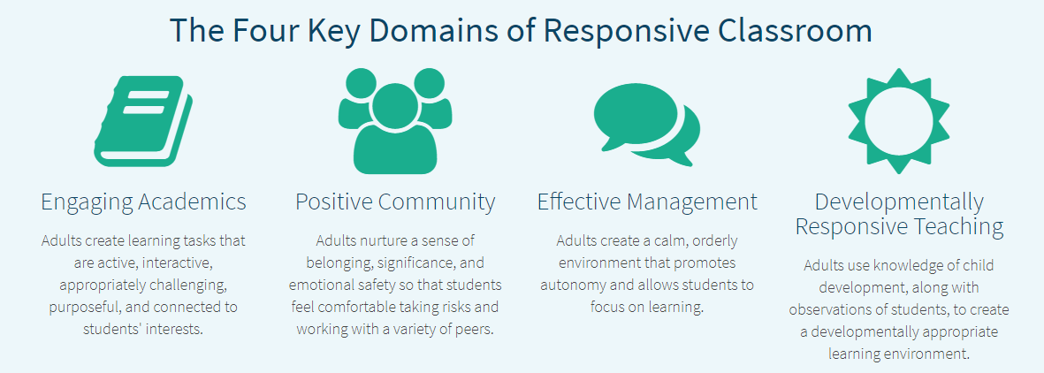

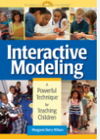





Responsive Classrooms
(social-emotional learning)
SPED 443/453
EDUC 221/422
EDUC 408
EDUC 316
EDUC 321
EDUC 204
EDUC 410

Slide 25
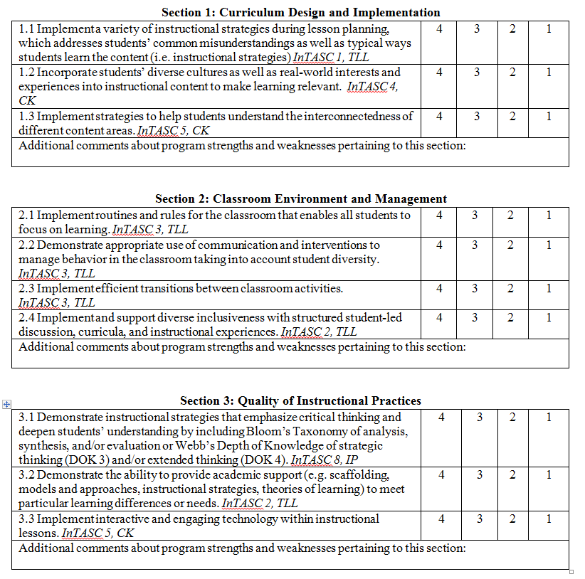
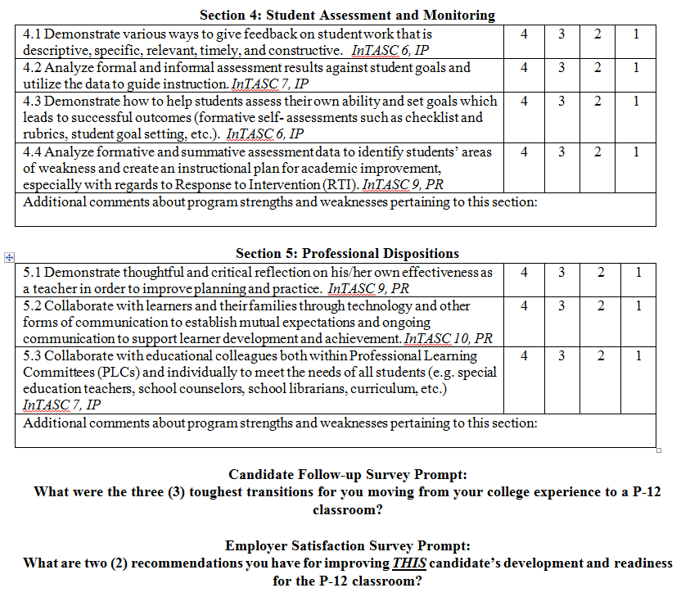
MSU Created Surveys
Notes:
4-well-prepared; 3- sufficiently prepared; 2- not sufficiently prepared; 1- not at all prepared
Benchmark is a 3.
5 sections that match the MSU FEE. 4 sections that match Compass evaluation (exclusion of professional dispositions)
Candidate Follow-up Survey Prompt:
What were the three (3) toughest transitions for you moving from your college experience to a P-12 classroom?
Employer Satisfaction Survey Prompt:
What are two (2) recommendations you have for improving THIS candidate’s development and readiness for the P-12 classroom?

Slide 26
MSU Created Survey:
Employer Satisfaction (ESS)
By the Numbers
Overall return rates:
Spring 2017 Completers: 16%
Fall 2017
Completers: 24%
Undergraduate
  InTASC standards and cross-cutting themes (technology/diversity) had mean range scores of 3.0-3.71.
MAT
  InTASC standards and cross-cutting themes (technology/diversity) had means range scores of 3.0-4.0
Notes:
Employer Satisfaction Survey
For both iterations of the ESS, overall undergraduate employers indicated their satisfaction with the EPP completers as measured by ‘sufficiently prepared’ or ‘well prepared’ mean scores on each InTASC standard as well as the cross-cutting themes of technology and diversity with mean range scores of 3.0-3.71. A score of 3.0 for fall 2017 concerning InTASC Standard 3 scored the lowest and a mean score of 3.71 for spring 2017 completers for InTASC standard 10 scored the highest. Undergraduate completers in elementary (n=2) and Biology (n=2) both had mean scores of 2.5 for InTASC Standard 3. Although overall ESS undergraduate scores indicated satisfaction with their employees’ preparation, the Secondary completers in Biology for spring 2017 (n=2) had scores that indicated ‘not sufficiently prepared’ for InTASC Standards 2-7 and 9 as well as diversity with a mean score of 2.33 with one completer scoring at ‘not at all prepared’.
For both iterations of the ESS, overall MAT employers indicated their satisfaction with the EPP completers as measured by ‘sufficiently prepared’ or ‘well prepared’ mean scores on each InTASC standard as well as the cross-cutting themes of technology and diversity with mean range scores of 3.0-4.0. A score of 3.0 for fall 2017 concerning InTASC standard 8 scored the lowest. Spring and fall 2017 completers scored 4.0 on InTASC standards 4 and 10. Although overall ESS MAT employers scores indicated satisfaction with their preparation, the Secondary completers in math for fall 2017 (n=1) had scores that indicated ‘not sufficiently prepared’ for InTASC standards.

Slide 27
MSU Created Survey:
Employer Satisfaction
In their own words…
Two recommendations for this completers:
Spring 2017 Completers:
  Classroom Environment and Management (43%)
  Quality of Instructional Practices (21%)
  Curriculum and Design and Implementation (14%)
  Student Assessment and Monitoring (14%)
  Professional Dispositions (7%)
Fall 2017 Completers:
  Classroom Environment and Management (33%)
  Quality of Instructional Practices (25%)
  Professional Dispositions (25%)
  Curriculum and Design and Implementation (8%)
  Student Assessment and Monitoring (8%)
Notes:
When aggregating the answers within the portion of the ESS where employers list two recommendations specific to spring and fall 2017 completers, Classroom Environment and Management (43% and 33%, respectively) and Quality of Instructional Practices (21% and 25%, respectively) were found to be the top two recommendations.

Slide 28
Employer Satisfaction Survey Conclusions
The majority of InTASC standards are scored at ‘well prepared’ and ‘sufficiently prepared’ for both semesters and undergraduate and alternative certification programs.
InTASC Standard 3 for elementary and secondary Biology for spring 2017 had mean scores of the ‘not sufficiently prepared’ at 2.5.
For both the Spring and Fall 2017, employers listed Classroom Environment and Management and Quality of Instructional Practices as the highest recommendation areas for improvement.

Slide 29
Employer Satisfaction
Next Steps
An Engagement and Motivation course was added to the elementary undergraduate program during the redesign in addition to the Classroom Management course.
PBC and MAT elementary programs will now offer a combined Classroom Management and Engagement and Motivation course.

Slide 30
MSU Created Survey:
Completer Follow-up (CFS)
By the Numbers
Overall return rates:
Spring 2017 completers: 31%
Fall 2017 Completers: 71%
Including:
6% unemployed
9% teaching out of their field
Undergraduate
  InTASC standards and cross-cutting themes (technology/diversity) had mean range scores of 2.97-3.33.
MAT
  InTASC standards 1, 3, 4, and 10 had range scores of 3.0-4.0 for both semesters meaning all completers (n=7) scored at ‘sufficiently prepared’ or ‘well prepared’.
  InTASC standard 3 had a mean score of 2.89 (n=3) which falls within the ‘not sufficiently prepared’ category.
PBC
  InTASC standard 10 had mean range scores of 3.0-4.0.
  InTASC standards 1, 2, 4-6, 8-9, and diversity had mean range scores of 2.67-2.83.
Notes:
Completer Follow-up Survey
Although overall undergraduate scores indicated satisfaction with their preparation, Standard 3 with a mean score of 2.97 (n=12) was scored low in Elementary (n=5, m=2.67) and all secondary programs (n=5, m=2.93) according to Spring 2017 respondents.
For both iterations of the CFS, overall MAT completers indicated satisfaction with their EPP as measured by ‘sufficiently prepared’ or ‘well prepared’ mean scores on the following InTASC standards 1, 3, 4, and 10 with mean range scores of 3.0-3.17. Fall 2017 completers indicated that for InTASC standard 3 with a mean score of 2.89 (n=3), they felt they were ‘not sufficiently prepared’.
For the Fall 17 iteration of the CFS, overall PBC completers (n=4) indicated satisfaction with their EPP as measured by all scores of ‘sufficiently prepared’ or ‘well prepared’ mean scores for InTASC standard 10. InTASC standards 1, 2, 4-6, 8-9 and diversity had means range scores of 2.67-2.83 which falls within the ‘not sufficiently prepared’ category. When disaggregating the data, elementary (n=2) scored at the ‘not sufficiently prepared’ category for all InTASC standards except 8, 10, and technology; whereas, the secondary agriculture completer scored in the range of 3.0-4.0 in all categories except InTASC standard 8. The EPP had only one PBC completer response for the fall 2017 semester who scored 4.0 on all InTASC standards.

Slide 31
MSU Created Survey:
Completer Follow-up
In their own words…
What are your toughest transitions from college to the classroom?
Spring 2017 Completers:
  Classroom Environment and Management (33%)
  Professional Dispositions (25%)
  Curriculum and Design and Implementation (16%)
  Quality of Instructional Practices (14%)
  Student Assessment and Monitoring (12%)
Fall 2017 Completers:
  Professional Dispositions (39%)
  Classroom Environment and Management (24%)
  Quality of Instructional Practices (17%)
  Curriculum and Design and Implementation (11%)
  Student Assessment and Monitoring (9%)
Notes:
When aggregating the answers within the portion of the CFS where completers list two of their toughest transitions moving from college to the classroom specific to spring and fall 2017, Classroom Environment and Management (33% and 24%, respectively) and Professional Dispositions (25% and 39%, respectively) were listed with Classroom Environment and Management scoring at the top of the list for spring 2017 completers and Professional Dispositions scoring at the top of the list for fall 2017 completers.

Slide 32
Quotes from Spring 2017 Completer Follow-up Surveys
It was tough to move from the college experience to an elementary classroom. The first was classroom management. I had a good idea on classroom management from the courses I have took, but I didn’t know how difficult it is to actually implement. You might think implementing one procedure would be easy, but the students might not think so. The second is inclusion. I have a lot of SPED students in my classroom and I struggle with keeping all of my students on the same task. I would really recommend encouraging future educators to not only go to “A” schools to observe or teach, but also go to the lower scored schools. This will allow future educators to experience the diverse environments of different schools. BS ELEM (Spring 2017)
I felt well prepared to transition into the classroom after my college experience. The toughest transitions I experienced were minor. I had to learn to trust my own minute-to-minute decisions without the immediate advice of a more experienced teacher. I also had to learn how to better manage my time. Most of my school days were spent in the classroom until late into the evening; I realized quickly that I should take advantage of any "free time" during the day. Lastly, I had to adjust to the slightly different culture in the school I am currently teaching in compared to the school that I student taught in. BACH SEC (Spring 2017)

Slide 33
Quotes from Spring 2017 Completer Follow-up Surveys
At McNeese there was a big support system and once entering the workforce there aren't people giving as much direction. BACH ECHD (Fall 2017)
I started teaching high school my second semester into the MAT program. The hardest part is trying to implement all of the information obtained in the courses. It takes a lot of practice as well as trial and error to have a well-managed and effective learning environment. MAT SEC (Fall 2017)
Deciding what processes to implement within your own classroom. We were provided so many different strategies and methods, but choosing what works in the classroom with a certain set of students was difficult. BACH ECHD (Fall 2017)

Slide 34
Completer Follow-up Survey Conclusions and Next Steps
CFS data indicates no trends can be established as each survey iteration shows strengths and challenges within the individual programs offered by the EPP (undergraduate, MAT, PBC).
Repeating indicators of ‘not sufficiently prepared’ for InTASC 3 have lead the EPP to plan to conduct a Differentiation professional development opportunity for all faculty, university supervisors, and mentor teachers during summer 2019.

Slide 35
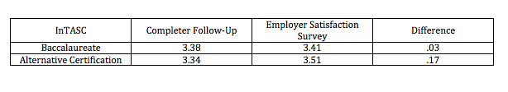
Employer Satisfaction Survey and Completer Follow-up Survey
Comparison
Combined results for both CFS and ESS administered for spring and fall 2017 indicated that employers rated completer abilities higher than our graduates by .03 for baccalaureate program completers and .17 for alternative certification program completers.

Slide 36
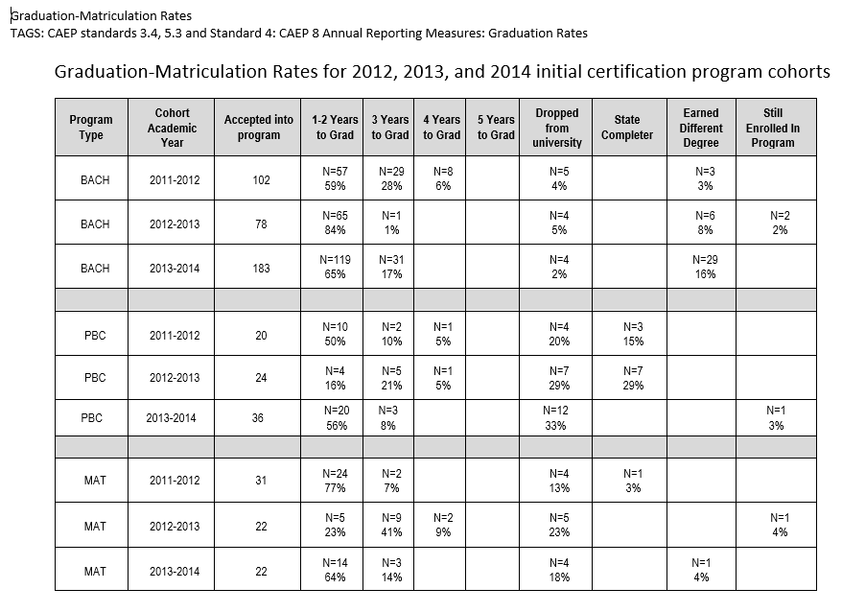
MSU Institutional Research Office
Graduation/Matriculation Rates
Notes:
Graduation/Matriculation Rates
Initial-Certification Programs
One measure of the effectiveness of an EPP is the matriculation of the candidates from acceptance into an initial certification program through graduation. When examining graduation data specific to matriculation rates for entering EPP candidates from the 2012, 2013, and 2014 cohorts, the following was noted: the majority of BACH completers finish their program within 1-2 years of officially being accepted within the EPP initial certification program (graduation rates at 59%, 84%, and 65% respectively); PBC and MAT completers finished their program at differing rates according to cohort. The 2013 PBC cohort had the lowest matriculation rate for 1-2 years to completion at 16%. PBC had state completers within the 2012 and 2013 cohorts, but 0% for the 2014 cohort. The 2012 MAT cohort had the highest matriculation rate at 77% for 1-2 year to completion with 23% being the lowest rate of matriculation for the 2013 cohort. The data presented within the matriculation chart for initial-certification programs for the number of candidates dropping from the university for the PBC and MAT programs is alarming.

Slide 37
Graduation/Matriculation Rates
Initial-certification Programs
Next Steps
During summer 2019, all PBC and MAT coursework will be redesigned to become online programs. Many of our candidates are working as classroom teachers and travel from long distances to attend face-to-face classes. This should alleviate the time constraints of working a full-time job and attending night classes several times a week.
Notes:
Graduation/Matriculation Rates
Initial-Certification Programs
Next Steps

Slide 38
Teach Louisiana:
Licensure and Employment Rates
(Initial Certification Programs)
Undergraduate
Year | Number of graduates | Percentage that began teaching year immediately | Percentage that was granted state license
2015-16 | 85 | 79% (n=67) | 97% (n=82)
2014-15 | 81 | 82% (n=66) | 99% (n=80)
2013-14 | 102 | 73% (n=74) | 100%
Alternative Certification
Year | Number of graduates | Percentage that began teaching year immediately | Percentage that was granted state license
2015-16 | 38 | 76% (n=29) | 97% (n=37)
2014-15 | 40 | 78% (n=31) | 100%
2013-14 | 37 | 67% (n=24) | 97% (n=36)
Notes:
Licensure Rates for
Initial-certification Programs
MSU EPP completers have a consistently high rate of receiving their state teaching licenses. An EPP requirement for each of the initial certification programs is that candidates must complete all licensure exams before beginning their student teaching/internship semesters. This program requirement means that once candidates have completed their student teaching/internship semesters, they have fulfilled all state requirements for licensing. For the three cycles of data collected, completers of all EPP initial-certification programs had a state licensure rate of 97% or higher over the last three years. The data shows that over the course of three cycles, with all three programs accounted for, only six (6) completers out of a total of 383 did not submit their paperwork to become a licensed teacher in the state of Louisiana.
Employment Rates for
Initial-certification Programs
Although licensure rates for all three programs are very high, employment rates for the licensed completers are much lower. Employment rates included with the LBoR Data Dashboard and Factbook take into account only the completers who gain employment within the state of Louisiana and in a public P-12 setting. If a completer gained employment outside of the state or within private daycare or non-public P-12 school settings including charter schools, then the EPP does not get credit for that employment. Using the data from the LBoR Data Dashboard, the lowest percentages of completers gaining employment within public school systems in the state of Louisiana came during our 2014 cohorts for both undergraduate and alternative certification programs. The fluctuation of percentages in between the three cohorts does not indicate any patterns or trends.

Slide 39
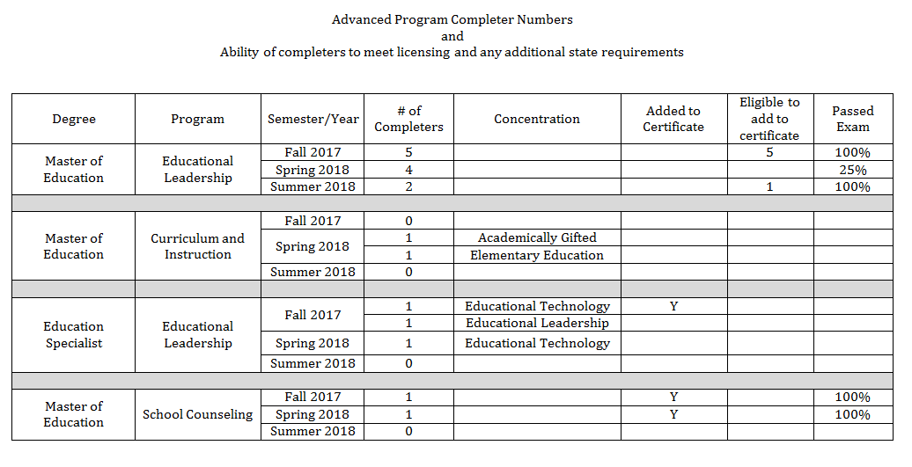
Teach Louisiana:
Graduation and Licensure Rates
Advanced Programs
Notes:
Graduation and Licensure Rates
Advanced Programs
Advanced programs for the 2017-2018 academic year have low enrollment. Master of Education in Educational Leadership had 11 completers, the Master of Education in Curriculum and Instruction had 2 completers, the Educational Specialist in Educational Leadership had 3 completers, and the Master of Education in School Counseling had 2 completers. Fifty percent (50%) of completers added their new certification area to their Louisiana teaching license. Specific to the Master of Education in Educational Leadership: EDLD candidates cannot add an EDLD certification to their teaching license until they are hired by a district in the official capacity of an Educational Leader. They are only ‘eligible’ to hold the license.

Slide 40
Graduation and Licensure Rates
Advanced Programs
Next Steps
During the 2019-2020 academic year, the EPP will evaluate current programs and determine new programs for implementation.
Mentor Training Pilot for 2019-2020 which will be included in newly redesigned advanced programs moving forward.
Notes:
Graduation and Licensure Rates
Advanced Programs
Next Steps

Slide 41
United States Department of Education:
MSU Loan Default Rates
Fiscal Year | 2015 | 2014 | 2013
Default rate | 9.9% | 11% | 12.4%
# in default | 178 | 195 | 224
# in repayment | 1,795 | 1,758 | 1,805
Information retrieved from National Center for Education Statistics athttps://nces.ed.gov/collegenavigator/?q=mcneese+state+university&s=all&id=159717#fedloans
**FY 2015 national cohort default rate is 10.8%
Information retrieved from Federal Student Aid website at https://www2.ed.gov/offices/OSFAP/defaultmanagement/cdr.html
Notes:
Cohort Default Rates
MSU cohort default rates for the enrollment years of 2013-2015 are as follows: 12.4%, 11%, and 939%, respectively. The reported cohort default rates are for all students enrolled in MSU, not just those specific to the EPP. The national cohort default rate for the 2015 fiscal year was 10.8%. The conclusions from this data are that the default rates of MSU students have had a steady decline over the last three reporting years, and MSU students have a lower cohort default rate by almost 1% less than the national average.

Slide 42
Questions??
Contact Dr. Angel Ogea, Dean, Burton College of Education
aogea@mcneese.edu

