Slide 1

Natural Gas Safety
SMELL---GO---LET US KNOW!!

Slide 2
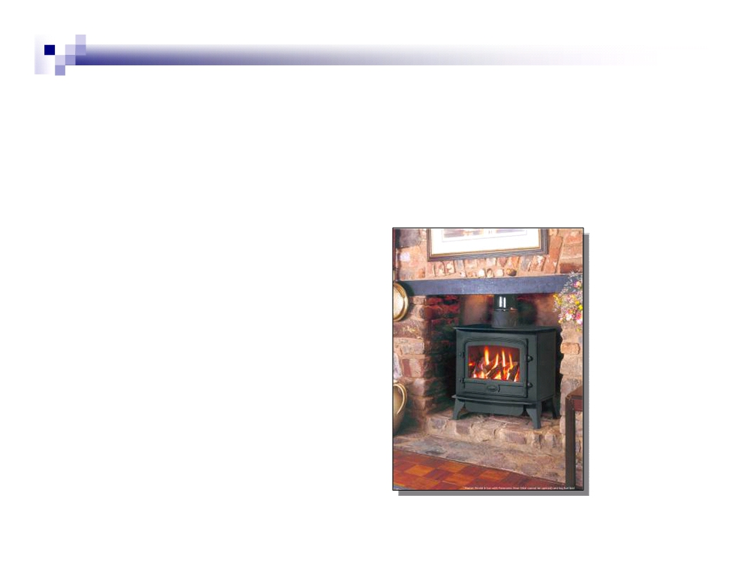
Knowledge is Safety
Approximately 52% of all U.S. households
use natural gas for
Home heating
Cooking
Water heaters
Gas logs
Outdoor gas grills

Slide 3
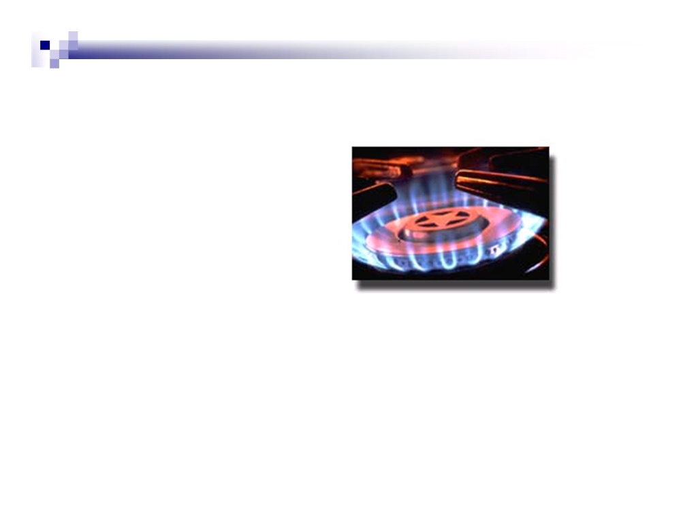
Why Use Natural Gas?
Natural gas is
Efficient
Clean-burning
Plentiful
Most natural gas used in the United States is
produced in North America.
Safe

Slide 4

Physical Properties of Natural Gas
Odorless - Mercaptan is added to make it easier to
detect a leak. Mercaptan smells similar to rotten eggs.
Colorless
Non-toxic. Breathing it in is not harmful as long as there
is an adequate supply of fresh air along with it.
Combustible. It will not burn by itself, but will burn with
an ignition source when combined with a certain mixture
of air.
Lighter than air. Natural gas will rise to the highest point
and accumulate.

Slide 5
Characteristics and Hazards of
Natural Gas
Natural gas is composed of hydrocarbon gases,
primarily methane. It burns only when both of the
following conditions are present:
The area’s atmosphere is 4.5% to 14.5% gas
There is an ingredient present that can raise the
temperature to 1,100-1,200 degrees - such as a pilot
light in a controlled situation or a spark which leads to
uncontrolled burning and possible explosion.
Sparks can be caused by doorbells, telephones, turning a
light switch on or off, etc.

Slide 6
Characteristics and Hazards of
Natural Gas
When natural gas burns completely,
carbon dioxide - a harmless gas – is
formed.
But, when natural gas is burned
incompletely, a carbon monoxide is
formed. Carbon monoxide is deadly.

Slide 7
Carbon Monoxide
Carbon monoxide (CO) is formed when
most common fuels - charcoal, coal,
gasoline, kerosene, oil, wood, propane,
natural gas - are burned without a
sufficient supply of air.
Carbon monoxide (CO) is odorless,
tasteless and invisible.

Slide 8
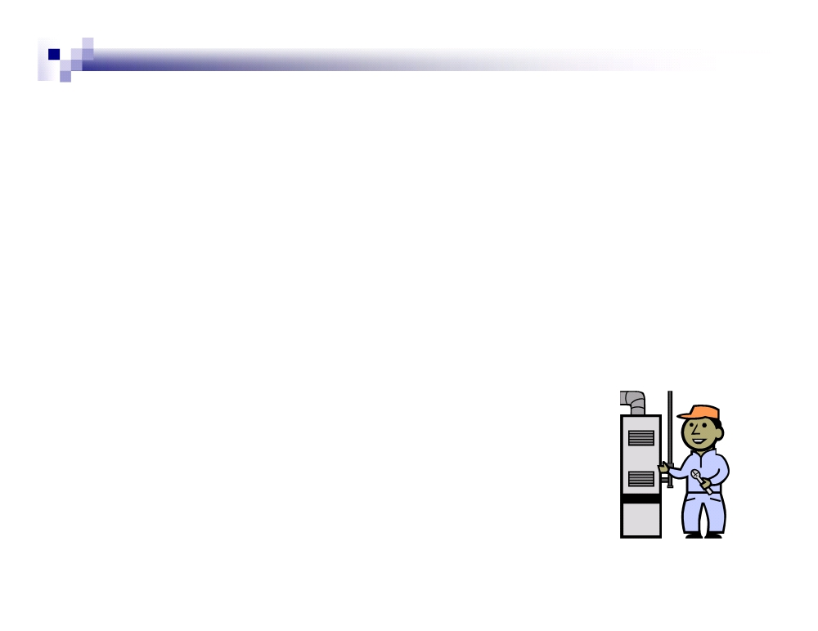
Carbon Monoxide
An appliance could generate CO if
Items or materials - boxes, laundry, etc. - are
blocking the base and restricting air flow
Vent hood, pipes or flues are blocked or corroded
The unit is improperly installed or adjusted. (Have
your natural gas appliances serviced by a
professional annually.)
It’s used incorrectly - i.e., grilling indoors,
heating a room with a gas stove, etc.)
The heat exchanger is cracked

Slide 9

Symptoms of CO Poisoning
The early effects of CO poisoning mimic the flu,
so watch for these warning signs:
Headache
Nausea or vomiting
Dizziness and disorientation
Muscle weakness or fatigue
If there is no fever, or if everyone in the house is
ill, or if the symptoms disappear when you leave
the house, it could be a CO problem.
Carbon monoxide detectors can be purchased
and installed much like fire detectors

Slide 10

If you suspect carbon monoxide is
in your dorm room or building:
Leave the premises immediately
Call University Police 475-5711

Slide 11

Recognizing Emergency
Conditions
Every emergency situation has potential
consequences that could endanger public
safety, damage equipment, and interrupt
gas delivery.
While causes and impacts vary, they all
have one thing in common - all require an
immediate response.

Slide 12

Five Basic Emergencies
Major gas leaks or line breaks
Fires and ignitions
Damage to gas equipment or facilities -
from compressors to pipe to meters to
appliances
Abnormal pressure
Loss of service

Slide 13
What Leads to Emergencies
Corrosion
Line stress - pipe movement, improper installation, earth
movement, icicles from severe weather
Pipe damage - most often digging without first locating
underground utilities
Call LA One Call at 811 first!
Construction defects - material damage during
transportation or handling, improper installation
Mechanical failure
Unsafe location for meter or regulator, e.g. vehicular
damage

Slide 14
Recognizing Natural Gas Leaks
Warning signals can be seen, smelled or
heard.
Any suspected gas leak must be
immediately reported
Call University Police at 475-5711.

Slide 15

Recognizing Natural Gas Leaks
Recognizing gas leaks by sight:
Dead or dying vegetation over buried gas lines
Unusual changes to soil - blackening, mildew, etc
Dry, blowing dirt near a gas line
Bubbling water over a gas line
Extensive corrosion on the meter set
Unusual swarms of insects or piles of dead insects
that may have been attracted to and killed by leaking
gas

Slide 16

Recognizing Natural Gas Leaks
Recognizing gas leaks by
smell:
In its natural state, natural
gas is odorless. Odorant is
added to give it a distinctive
smell, similar to rotten eggs.
SMELL---GO---LET US KNOW!!

Slide 17

Recognizing Natural Gas Leaks
Recognizing gas leaks by sound:
If a gas leak is large enough, there
may be a hissing sound coming out of
the meter, connections, or from the
ground.
But hissing sounds at high-capacity
sites could be normal due to the
sound of gas going through the
system.

Slide 18

DO NOT ENTER!
If you smell gas inside a building as you
approach, do not enter.
Call University Police from outside of the
building.
475-5711
SMELL---GO---LET US KNOW!!

Slide 19

If you’re inside a building
and smell gas, do not
Smoke or strike a match
Operate any electrical switches or
appliance controls
Pull any plugs from outlets
Use a flashlight or lighter
Use a telephone or cell phone from inside
the building
SMELL---GO---LET US KNOW!!

Slide 20

If you’re inside a building
and smell gas, do
Leave the premises immediately
Call University Police from a safe
distance outside of the building.
475-5711
SMELL---GO---LET US KNOW!!

Slide 21
Know Your Ignition Sources
Natural gas is highly combustible and
accidental contact with an ignition source
can result in fire or explosion. Ignition
sources can be either open flame or
electrical.
Open flame: Cigarettes, lights, matches,
lanterns, candles, etc.
Electrical: Arcing or static electricity

Slide 22

Electrical Ignition
Arcing
A tiny electrical spark caused by, but not
limited to, doorbells, lights, all types of
telephones, appliances, pagers, 2-way radios,
hand tools, motorized equipment

Slide 23

LA One Call
Call 811 before you dig!
The greatest risk to underground
pipelines is accidental damage during
excavation.
The law requires all excavators to
notify 811 at least two full working
days before digging.

Slide 24
REMEMBER THIS:
Natural Gas Safety
SMELL---GO---LET US KNOW!!

