Slide 1
CAEP
Standard 4
McNeese State University
Spring 2020
CAEP Update Presentation

Slide 2

InTASC Standards
  The Learner and Learning
    Standard 1-
    Learner Development
    Standard 2-
    Learning Differences
    Standard 3-
    Learning Environments
  Content Knowledge
    Standard 4-
    Content Knowledge
    Standard 5-
    Application of Content
  Instructional Practice
    Standard 6-
    Assessment
    Standard 7-
    Planning for Instruction
    Standard 8-
    Instructional Strategies
  Professional Responsibility
    Standard 9-
    Professional Learning and Ethical Practice
    Standard 10-
    Leadership and Collaboration

Slide 3
Standard 4
The provider demonstrates the impact of its completers on P-12 student learning and development, classroom instruction, and schools, and the satisfaction of its completers with the relevance and effectiveness of their preparation.

Slide 4
8 Annual Reporting Measure
Program Impact:
  P-12 student learning/
  development
  Observations of teaching effectiveness
  Employer satisfaction
  Completer persistence
Program Outcome and Consumer Information:
  Completer or graduation rates
  Licensure rate
  Employment rate
  Consumer information, including students loan default rate

Slide 5
Louisiana Department of Education Expectations
Highly Effective:
4.0-3.5
Effective: Proficient:
3.49-2.5
Effective: Emerging:
2.49-1.5
Ineffective:
1.49-1.0
Notes:
MSU FEE is aligned with Louisiana Compass Evaluation except for the addition of two sections: Classroom Management and Professional Dispositions. The LDoE has a set benchmark of 1.5 or higher for employed educators.

Slide 6
Impact of P-12 learning and development (CAEP 4.1)
Louisiana Board of Regents statement: "Due to discrepancies found in data used to calculate Growth in Student Learning Scores and Compass Teacher Evaluation Scores for new teachers completing individual teacher preparation programs, it was not possible to release 2019 Teacher Preparation Data Dashboards or create a 2019 Teacher Preparation Fact Book. Please go to the USDE Title 2 website at https://Title2.ed.gov to locate information about teacher preparation programs pertaining to: listing of programs, number of enrolled candidates, race and gender of enrolled candidates, number of completers, GPA of completers, Praxis passage rates, and other relevant information.”

Slide 7
Indicators of teaching effectiveness (CAEP 4.2)
Louisiana Board of Regents statement: "Due to discrepancies found in data used to calculate Growth in Student Learning Scores and Compass Teacher Evaluation Scores for new teachers completing individual teacher preparation programs, it was not possible to release 2019 Teacher Preparation Data Dashboards or create a 2019 Teacher Preparation Fact Book. Please go to the USDE Title 2 website at https://Title2.ed.gov to locate information about teacher preparation programs pertaining to: listing of programs, number of enrolled candidates, race and gender of enrolled candidates, number of completers, GPA of completers, Praxis passage rates, and other relevant information.”

Slide 8
2018 Louisiana Fact Book and
Data Dash Boards: Undergraduate
Year | Mean Number | Ineffective | Effective: Emerging | Effective: Proficient | Highly Effective
Compass Student Growth (SLT/VAM) (CAEP 4.1)
2016 | 3.4 (n=446) | 3% | 7% | 28% | 63%
2017 | 3.4 (n=422) | 1% | 10% | 23% | 66%
2018 | 3.4 (n=360) | 1% | 10% | 19% | 70%
Compass Professional Practice (Observation Evaluations) (CAEP 4.2)
2016 | 3.2 (n=446) | 1% | 8% | 62% | 30%
2017 | 3.2 (n=422) | 1% | 7% | 55% | 37%
2018 | 3.3 (n=360) | 1% | 6% | 48% | 45%
Compass Final Evaluation (Average of two categories)
2016 | 3.3 (n=446) | 3% | 6% | 51% | 41%
2017 | 3.4 (n=422) | 2% | 7% | 45% | 46%
2018 | 3.4 (n=360) | 1% | 7% | 38% | 54%
Notes:
Louisiana Board of Regents statement: "Due to discrepancies found in data used to calculate Growth in Student Learning Scores and Compass Teacher Evaluation Scores for new teachers completing individual teacher preparation programs, it was not possible to release 2019 Teacher Preparation Data Dashboards or create a 2019 Teacher Preparation Fact Book. Please go to the USDE Title 2 website at https://Title2.ed.gov to locate information about teacher preparation programs pertaining to: listing of programs, number of enrolled candidates, race and gender of enrolled candidates, number of completers, GPA of completers, Praxis passage rates, and other relevant information.“
Previously reported data indicate that MSU EPP undergraduate completers are having a positive impact on P-12 learning and development (CAEP 4.1) and have strong instructional practices leading to high levels of teaching effectiveness (CAEP 4.2).
Using information reported by the LBoR Data Dashboards, MSU undergraduate completers with teaching experience of 1 and 2 years, have a steady mean score of 3.4 for CAEP 4.1 which is at the high end of the Effective: Proficient range (2.5-3.49) over the last three reporting years with a state benchmark of 1.5. Also noted is that 89-91% of our undergraduate candidates have scored at or above the Effective: Proficient range (2.5 or above) during the 2016-2018 reporting dates. Using data reported within the LBoR Fact Book, MSU completers ranked second out of the 14 Louisiana public universities in which data is provided with a mean score of 3.4 for 2018 in Compass student growth (SLT/VAM) (CAEP 4.1). Growth of 7% over the last three years for completers scoring within the Highly Effective range for CAEP 4.1 is noted as a positive trend.
Using information reported by the LBoR Data Dashboards, MSU undergraduate completers with teaching experience of 1 and 2 years have a mean score of 3.2-3.3 for CAEP 4.2 which falls within the range of Effective: Proficient (2.5-3.49) over the last three reporting years with a state benchmark of 1.5. Also noted is that 92-93% of our undergraduate candidates have scored at or above the Effective: Proficient range (2.5 or above) during the 2016-2018 reporting dates. Using data reported within the LBoR Fact Book, MSU completers ranked first out of the 14 Louisiana public universities in which data is provided with a mean score of 3.3 for 2018 in Compass professional practice (CAEP 4.2). Growth of 15% over the last three years for completers scoring within the Highly Effective range for CAEP standard 4.2 measures is noted as a positive trend.
Using information reported by the LBoR Data Dashboards, MSU undergraduate completers with teaching experience of 1 and 2 years, have a combined mean score (3.3-3.4) for CAEP measures 4.1 and 4.2 at the high end of the Effective: Proficient over the last three reporting years with a state benchmark of 1.5. Also noted is 91-92% of our undergraduate candidates had a combined mean score at or above the Effective: Proficient range (2.5 or above) during the 2016-2018 reporting dates. Using data reported within the LBoR Fact Book, MSU undergraduate completers ranked first out of the 14 Louisiana public universities in which data is provided with a mean score of 3.4 for 2018 in Compass Final Evaluation Scores (combined 4.1 and 4.2 measures). Growth of 13% when combining CAEP 4.1 and 4.2 measures in the Highly Effective range are noted as positive trends.
Data for the last two reporting cycles (2017-2018) have remained steady for the number of undergraduate candidates scoring in the Ineffective (1.0-1.49) and Effective: Emerging (1.5-2.49) ranges for all both CAEP impact measures (4.1 and 4.2).

Slide 9
2018 Louisiana Fact Book and
Data Dash Boards:
Master of Arts in Teaching (MAT)
Year | Mean Number | Ineffective | Effective: Emerging | Effective: Proficient | Highly Effective
Compass Student Growth (SLT/VAM) (CAEP 4.1)
2016 | 3.4 (n=179) | 3% | 6% | 27% | 64%
2017 | 3.5 (n=120) | 1% | 6% | 22% | 72%
2018 | 3.6 (n=78) | 1% | 8% | 15% | 76%
Compass Professional Practice (Observation Evaluations) (CAEP 4.2)
2016 | 3.3 (n=179) | 0% | 7% | 51% | 42%
2017 | 3.2 (n=120) | 0% | 8% | 44% | 48%
2018 | 3.4 (n=78) | 0% | 6% | 37% | 56%
Compass Final Evaluation (Average of two categories)
2016 | 3.4 (n=179) | 3% | 3% | 49% | 45%
2017 | 3.5 (n=120) | 1% | 3% | 43% | 53%
2018 | 3.6 (n=78) | 1% | 3% | 35% | 62%
Notes:
Louisiana Board of Regents statement: "Due to discrepancies found in data used to calculate Growth in Student Learning Scores and Compass Teacher Evaluation Scores for new teachers completing individual teacher preparation programs, it was not possible to release 2019 Teacher Preparation Data Dashboards or create a 2019 Teacher Preparation Fact Book. Please go to the USDE Title 2 website at https://Title2.ed.gov to locate information about teacher preparation programs pertaining to: listing of programs, number of enrolled candidates, race and gender of enrolled candidates, number of completers, GPA of completers, Praxis passage rates, and other relevant information.“
Previously reported data indicate that MSU EPP MAT completers are having a positive impact on P-12 learning and development (CAEP 4.1) and have strong instructional practices leading to high levels of teaching effectiveness (CAEP 4.2).
Using information reported by the LBoR Data Dashboards, MSU MAT completers with teaching experience of 1 and 2 years, have an increasing mean score from 3.4 to 3.6 for CAEP 4.1 which falls in the high end of the Effective: Proficient category (2.5-3.49) and within the Highly Effective range (3.5-4.0) over the last three reporting years with a state benchmark of 1.5. Also noted is that 91-94% of our MAT candidates have scored at or above the Effective: Proficient range (2.5 or above) during the 2016-2018 reporting dates. Using data reported within the LBoR Fact Book, MSU MAT completers ranked first out of the 9 Louisiana public universities in which data is provided with a mean score of 3.6 for 2018 in Compass student growth (SLT/VAM) (CAEP 4.1). Growth of 12% over the last three years for completers scoring within the Highly Effective range for CAEP 4.1 is noted as a positive trend.
Using information reported by the LBoR Data Dashboards, MSU MAT completers with teaching experience of 1 and 2 years, have a mean score of 3.2-3.4 for CAEP 4.2 which falls within the range of Effective: Proficient (2.5-3.49) over the last three reporting years with a state benchmark of 1.5. Also noted is that 92-93% of our MAT candidates have scored at or above Effective: Proficient range (2.5 or above) during the 2016-2018 reporting dates. Using data reported within the LBoR Fact Book, MSU completers ranked first out of the 9 Louisiana public universities in which data is provided with a mean score of 3.4 for 2018 in Compass professional practice (CAEP 4.2). Growth of 14% over the last three years for completers scoring within the Highly Effective range for CAEP standard 4.2 measures is noted as a positive trend.
Using information reported by the LBoR Data Dashboards, MSU MAT completers with teaching experience of 1 and 2 years, have a combined mean score (3.4-3.6) for CAEP measures 4.1 and 4.2 at the high end of the Effective: Proficient and the low end of Highly Effective over the last three reporting years with a state benchmark of 1.5. Also noted is 94-97% of our MAT candidates had a combined mean score at or above the Effective: Proficient range (2.5 or above) during the 2016-2018 reporting dates. Using data reported within the LBoR Fact Book, MSU MAT completers ranked first out of the 9 Louisiana public universities in which data is provided with a mean score of 3.6 for 2018 in Compass Final Evaluation Scores (combined CAEP 4.1 and 4.2 measures). Growth of 17% when combining CAEP 4.1 and 4.2 measures in the Highly Effective range are noted as positive trends.
Data for the last two reporting cycles (2017-2018) have remained steady for the number of MAT candidates scoring in the Ineffective (1.0-1.49) and Effective: Emerging (1.5-2.49) ranges for both CAEP impact measures (4.1 and 4.2).

Slide 10
2018 Louisiana Fact Book and
Data Dash Boards:
Alternative Certification (PBC)
Year | Mean Number | Ineffective | Effective: Emerging | Effective: Proficient | Highly Effective
Compass Student Growth (SLT/VAM) (CAEP 4.1)
2016 | 3.4 (n=105) | 1% | 10% | 26% | 64%
2017 | 3.5 (n=84) | 0% | 6% | 29% | 66%
2018 | 3.6 (n=80) | 0% | 4% | 25% | 71%
Compass Professional Practice (Observation Evaluations) (CAEP 4.2)
2016 | 3.3 (n=105) | 0% | 6% | 50% | 45%
2017 | 3.3 (n=84) | 0% | 4% | 49% | 48%
2018 | 3.4 (n=80) | 0% | 3% | 45% | 53%
Compass Final Evaluation (Average of two categories)
2016 | 3.4 (n=105) | 1% | 5% | 45% | 50%
2017 | 3.5 (n=84) | 0% | 5% | 42% | 54%
2018 | 3.6 (n=80) | 0% | 3% | 38% | 60%
Notes:
Louisiana Board of Regents statement: "Due to discrepancies found in data used to calculate Growth in Student Learning Scores and Compass Teacher Evaluation Scores for new teachers completing individual teacher preparation programs, it was not possible to release 2019 Teacher Preparation Data Dashboards or create a 2019 Teacher Preparation Fact Book. Please go to the USDE Title 2 website at https://Title2.ed.gov to locate information about teacher preparation programs pertaining to: listing of programs, number of enrolled candidates, race and gender of enrolled candidates, number of completers, GPA of completers, Praxis passage rates, and other relevant information.“
Previously reported data indicate that MSU EPP PBC completers are having a positive impact on P-12 learning and development (CAEP 4.1) and have strong instructional practices leading to high levels of teaching effectiveness (CAEP 4.2).
Using information reported by the LBoR Data Dashboards, MSU PBC completers with teaching experience of 1 and 2 years, have an increasing mean score from 3.4 to 3.6 for CAEP 4.1 which falls in the high end of the Effective: Proficient category (2.5-3.49) and within the Highly Effective range (3.5-4.0) over the last three reporting years with a state benchmark of 1.5. Also noted is that 90-96% of our PBC candidates have scored at or above the Effective: Proficient range (2.5 or above) during the 2016-2018 reporting dates. Using data reported within the LBoR Fact Book, MSU PBC completers ranked second out of the 11 Louisiana public universities in which data is provided with a mean score of 3.6 for 2018 in Compass student growth (SLT/VAM) (CAEP 4.1). Growth of 7% over the last three years for completers scoring within the Highly Effective range for CAEP 4.1 is noted as a positive trend.
Using information reported by the LBoR Data Dashboards, MSU PBC completers with teaching experience of 1 and 2 years, have a mean score of 3.3-3.4 for CAEP 4.2 which falls within the range of Effective: Proficient (2.5-3.49) over the last three reporting years with a state benchmark of 1.5. Also noted is that 95-98% of our PBC candidates have scored at or above Effective: Proficient range (2.5 or above) during the 2016-2018 reporting dates. Using data reported within the LBoR Fact Book, MSU PBC completers ranked second out of the 11 Louisiana public universities in which data is provided with a mean score of 3.4 for 2018 in Compass professional practice (CAEP 4.2). Growth of 8% over the last three years for completers scoring within the Highly Effective range for CAEP standard 4.2 measures is noted as a positive trend.
Using information reported by the LBoR Data Dashboards, MSU PBC completers with teaching experience of 1 and 2 years, have a combined mean score (3.4-3.6) for CAEP measures 4.1 and 4.2 at the high end of the Effective: Proficient over the last three reporting years with a state benchmark of 1.5. Also noted is 95-98% of our PBC candidates had a combined mean score at or above Effective: Proficient range (2.5 or above) during the 2016-2018 reporting dates. Using data reported within the LBoR Fact Book, MSU completers ranked first out of the 11 Louisiana public universities in which data is provided with a mean score of 3.6 for 2018 in Compass Final Evaluation Scores (combined CAEP 4.1 and 4.2 measures). Growth of 10% when combining CAEP 4.1 and 4.2 measures in the Highly Effective range are noted as positive trends.
Data for the last two reporting cycles (2017-2018) have remained steady for the number of PBC candidates scoring in the Ineffective (1.0-1.49) and Effective: Emerging (1.5-2.49) ranges for both CAEP impact measures (4.1 and 4.2).

Slide 11
Program Comparison
2018 Factbook and Data Dashboard
Compass Final Evaluation
(combined CAEP 4.1 and 4.2)
Program | Mean number | Ineffective | Effective: Emerging | Effective: Proficient | Highly Effective
Undergraduate | 3.4 (n=360) | 1% | 7% | 38% | 54%
MAT | 3.6 (n=78) | 1% | 3% | 35% | 62%
PBC | 3.6 (n=80) | 0% | 3% | 38% | 60%
Notes:
Louisiana Board of Regents statement: "Due to discrepancies found in data used to calculate Growth in Student Learning Scores and Compass Teacher Evaluation Scores for new teachers completing individual teacher preparation programs, it was not possible to release 2019 Teacher Preparation Data Dashboards or create a 2019 Teacher Preparation Fact Book. Please go to the USDE Title 2 website at https://Title2.ed.gov to locate information about teacher preparation programs pertaining to: listing of programs, number of enrolled candidates, race and gender of enrolled candidates, number of completers, GPA of completers, Praxis passage rates, and other relevant information.“

Slide 12
Completer Data Conclusions from 2018
(combined CAEP 4.1 and 4.2)
Undergraduate, MAT, and PBC completers teaching in their first or second year in the 2015-2016 academic year had mean scores of Effective Proficient to Highly Effective (m=3.4-3.6) in all three categories of Student Growth, Professional Practice, and Final Evaluations.
When combining all 4.1 and 4.2 data found within the LBoR Factbook and Data Dashboards and then comparing all three initial-certification program types, the PBC program has the highest percentage of completers scoring at the Effective: Proficient and Highly Effective range at 97%, followed by MAT program at 96%, and undergraduate program at 92%.
Notes:
Louisiana Board of Regents statement: "Due to discrepancies found in data used to calculate Growth in Student Learning Scores and Compass Teacher Evaluation Scores for new teachers completing individual teacher preparation programs, it was not possible to release 2019 Teacher Preparation Data Dashboards or create a 2019 Teacher Preparation Fact Book. Please go to the USDE Title 2 website at https://Title2.ed.gov to locate information about teacher preparation programs pertaining to: listing of programs, number of enrolled candidates, race and gender of enrolled candidates, number of completers, GPA of completers, Praxis passage rates, and other relevant information.“
When reviewing this previously reported data, it is noted that there has been an increase in mean score in undergraduate, MAT, and PBC programs for both CAEP 4.1 and 4.2 from 2016-2018.

Slide 13
Program Comparison
2018 Factbook and Data Dashboard
Compass Student Growth (SLT/VAM)
CAEP 4.1
Program | Mean number | Ineffective | Effective: Emerging | Effective: Proficient | Highly Effective
Undergraduate | 3.4 (n=360) | 1% | 10% | 19% | 70%
MAT | 3.6 (n=78) | 1% | 8% | 15% | 76%
PBC | 3.6 (n=80) | 0% | 4% | 25% | 71%
Notes:
Louisiana Board of Regents statement: "Due to discrepancies found in data used to calculate Growth in Student Learning Scores and Compass Teacher Evaluation Scores for new teachers completing individual teacher preparation programs, it was not possible to release 2019 Teacher Preparation Data Dashboards or create a 2019 Teacher Preparation Fact Book. Please go to the USDE Title 2 website at https://Title2.ed.gov to locate information about teacher preparation programs pertaining to: listing of programs, number of enrolled candidates, race and gender of enrolled candidates, number of completers, GPA of completers, Praxis passage rates, and other relevant information.“
Previously reported program completers teaching in Grades 4-8 in Math, Science, Social Studies, and ELA have a combined mean score for Student Learning Targets (SLT) and Value-Added Model (VAM) that show the majority of our completers score in the Effective: Proficient and Highly Effective range with high mean scores between 3.4-3.6.

Slide 14
Student Growth (VAM)
Disaggregation by Content Area: Undergraduate
Year | number | Ineffective | Effective: Emerging | Effective: Proficient | Highly Effective
Math
2016 | 37 | 41% | 35% | 19% | 5%
2017 | 11 | 64% | 18% | 0% | 18%
2018 | 14 | 50% | 29% | 7% | 14%
Science
2016 | 27 | 15% | 48% | 33% | 4%
2017 | 19 | 21% | 21% | 47% | 11%
2018 | 17 | 12% | 47% | 29% | 12%
Social Studies
2016 | 35 | 9% | 51% | 29% | 11%
2017 | -- | -- | -- | -- | --
2018 | -- | -- | -- | -- | --
English Language Arts
2016 | 45 | 27% | 42% | 27% | 4%
2017 | 11 | 21% | 26% | 32% | 21%
2018 | 22 | 18% | 32% | 32% | 18%
Notes:
Impact on P-12 Learning and Development (CAEP 4.1) using Value-Added Model (VAM) Data Only
Louisiana Board of Regents statement: "Due to discrepancies found in data used to calculate Growth in Student Learning Scores and Compass Teacher Evaluation Scores for new teachers completing individual teacher preparation programs, it was not possible to release 2019 Teacher Preparation Data Dashboards or create a 2019 Teacher Preparation Fact Book. Please go to the USDE Title 2 website at https://Title2.ed.gov to locate information about teacher preparation programs pertaining to: listing of programs, number of enrolled candidates, race and gender of enrolled candidates, number of completers, GPA of completers, Praxis passage rates, and other relevant information.“
Previously reported program completers teaching in Grades 4-8 an in Math, Science, Social Studies, and ELA have a combined score of Student Learning Targets (SLT) and Value-Added Model (VAM) as discussed earlier in this report. When examining data specific to student growth in these particular content areas and grade levels, the following is an analysis of program completers’ data specific to VAM scores only. These scores are only calculated if our program has 25 or more completers within the grade level and content area.
Undergraduate Program Completers
Trend data indicates a growing strength for MSU undergraduate program completers who teach in grades 4-8 in the content area of ELA moving from 27% scoring Ineffective (1.0-1.49) for the 2016 LBoR report to 18% scoring Ineffective for the 2018 LBoR report which is a 9% decrease. Meaning 82% of our undergraduate completers met the state benchmark of 1.5 or higher.
No trend data is indicated within undergraduate program completers who teach in grades 4-8 for Math or Science as fluctuating percentages are found within the three years of reporting data (2016- 2018) by the LBoR. Our highest percentage of undergraduate completers scoring within the Ineffective range (1.0-1.49) can be found within the math content. Forty-one to sixty-four percent (41-64%) of completers are not having a positive impact on student growth in Math grades 4-8.
When examining MSU undergraduate VAM scores with other 11 public universities within Louisiana, it was determined that MSU candidates ranked last in math, 6th in science, and 3rd in ELA.

Slide 15
Student Growth (VAM)
Disaggregation by Content Area:
Master of Arts in Teaching (MAT)
Year | number | Ineffective | Effective: Emerging | Effective: Proficient | Highly Effective
Math
2016 | 34 | 12% | 53% | 21% | 15%
2017 | -- | -- | -- | -- | --
2018 | -- | -- | -- | -- | --
Science
2016 | 29 | 14% | 59% | 14% | 14%
2017 | 12 | 0% | 75% | 0% | 25%
2018 | 10 | 10% | 80% | 0% | 10%
English Language Arts
2016 | 28 | 21% | 43% | 25% | 11%
2017 | -- | -- | -- | -- | --
2018 | 11 | 0% | 46% | 36% | 18%
Notes:
Impact on P-12 Learning and Development (CAEP 4.1) using Value-Added Model (VAM) Data Only
MAT Program Completers
Louisiana Board of Regents statement: "Due to discrepancies found in data used to calculate Growth in Student Learning Scores and Compass Teacher Evaluation Scores for new teachers completing individual teacher preparation programs, it was not possible to release 2019 Teacher Preparation Data Dashboards or create a 2019 Teacher Preparation Fact Book. Please go to the USDE Title 2 website at https://Title2.ed.gov to locate information about teacher preparation programs pertaining to: listing of programs, number of enrolled candidates, race and gender of enrolled candidates, number of completers, GPA of completers, Praxis passage rates, and other relevant information.“
Previously reported trend data indicates a growing strength for MSU MAT program completers who teach in grades 4-8 in the content area of ELA moving from 21% scoring Ineffective (1.0-1.49) for the 2016 LBoR report to 0% scoring Ineffective for the 2018 LBoR report which is a 21% decrease. Meaning 100% of our MAT program completers met the state benchmark of 1.5 or higher in 2018.
No trend data is indicated within MAT program completers who teach in grades 4-8 for Science as fluctuating percentages are found within the three years of reporting data (2016- 2018) by the LBoR. Also, Math VAM data for MAT program completers was only given for the 2016 reporting year.
When examining MSU MAT VAM scores with other 6 public universities within Louisiana who had data reported for the content area of Science, it was determined that MSU completers ranked higher than 2 universities pertaining to the percentage of completers scoring Ineffective. When examining MSU MAT VAM scores with the other 7 public universities within Louisiana who had data reported for the content area of ELA, it was determined that MSU completers ranked higher than 5 universities pertaining to the percentage of completers scoring Ineffective.

Slide 16
Student Growth (VAM)
Disaggregation by Content Area:
Alternative Certification (PBC)
Year | number | Ineffective | Effective: Emerging | Effective: Proficient | Highly Effective
English Language Arts
2016 | 25 | 28% | 36% | 24% | 12%
2017 | -- | -- | -- | -- | --
2018 | 10 | 30% | 50% | 10% | 10%
Notes:
Impact on P-12 Learning and Development (CAEP 4.1) using Value-Added Model (VAM) Data Only
PBC Program Completers
Louisiana Board of Regents statement: "Due to discrepancies found in data used to calculate Growth in Student Learning Scores and Compass Teacher Evaluation Scores for new teachers completing individual teacher preparation programs, it was not possible to release 2019 Teacher Preparation Data Dashboards or create a 2019 Teacher Preparation Fact Book. Please go to the USDE Title 2 website at https://Title2.ed.gov to locate information about teacher preparation programs pertaining to: listing of programs, number of enrolled candidates, race and gender of enrolled candidates, number of completers, GPA of completers, Praxis passage rates, and other relevant information.“
Previously reported data indicates an increase in MSU PBC program completers scoring Ineffective (1.0-1.5) in the content area of ELA for grades 4-8. Meaning 70% of our PBC completers scored higher than the state benchmark of 1.5. When examining MSU PBC VAM scores with other 6 public universities within Louisiana who had data reported for the content area of ELA, it was determined that MSU completers ranked last pertaining to the percentage of completers scoring Ineffective.

Slide 17
P-12 Learning and Development Conclusions from 2018
(CAEP 4.1)
Undergraduate, MAT, and PBC completers teaching in their first or second year in 2015-2016 academic year had mean scores of Effective Proficient to Highly Effective (m=3.4-3.6) in Student Growth when SLTs and VAM scores are combined.
Disaggregated VAM scores by grade level and content area for undergraduate completers, indicate math as an area of challenge.
ELA in undergraduate and MAT has our highest scoring content area percentages ranked at 3rd and 4th, respectively, in the state.
Notes:
Louisiana Board of Regents statement: "Due to discrepancies found in data used to calculate Growth in Student Learning Scores and Compass Teacher Evaluation Scores for new teachers completing individual teacher preparation programs, it was not possible to release 2019 Teacher Preparation Data Dashboards or create a 2019 Teacher Preparation Fact Book. Please go to the USDE Title 2 website at https://Title2.ed.gov to locate information about teacher preparation programs pertaining to: listing of programs, number of enrolled candidates, race and gender of enrolled candidates, number of completers, GPA of completers, Praxis passage rates, and other relevant information.“

Slide 18
P-12 Learning and Development
Next Steps
(CAEP 4.1)
Teaching Cycle in all methods courses
Assessment course redesign
Deans for Impact Collaborative implementation of four-semester math content and methods redesign
Addition of Tier 1 curriculum
Domain 5 aligning to Louisiana Preparation Teacher Competencies
Notes:
Louisiana Board of Regents statement: "Due to discrepancies found in data used to calculate Growth in Student Learning Scores and Compass Teacher Evaluation Scores for new teachers completing individual teacher preparation programs, it was not possible to release 2019 Teacher Preparation Data Dashboards or create a 2019 Teacher Preparation Fact Book. Please go to the USDE Title 2 website at https://Title2.ed.gov to locate information about teacher preparation programs pertaining to: listing of programs, number of enrolled candidates, race and gender of enrolled candidates, number of completers, GPA of completers, Praxis passage rates, and other relevant information.“
After reviewing the previously reported CAEP 4.1 and 4.2 data, several new collaborations and additions were made with our redesigned initial certification programs. For completers, using data to drive instruction is a skill that needs to be practiced as shown by data when VAM scores are disaggregated out from our VAM/SLT scores. Completers must be able to use summative data, beginning of the year testing data, and progress monitoring to determine student level of mastery of the standards. The redesigned Assessment Course and Teaching Cycle portfolio incorporate the analysis of summative data and student inventories in order to create a lesson plan tied to the assigned field placement within each methodology course. Candidates then analyze student artifact data from the lesson to determine areas of strengths and weaknesses and what post-lesson scaffolding should look like as a next step for supporting student mastering the content.
It was noted that MSU had a high percentage of completers scoring at the Ineffective range according to our VAM data for Math grades 4-8. Due to this, MSU participated in the Deans for Impact Collaborative during the 2018-2019 academic year with a strategic focus on Math preparation. We have realigned four Math courses (two in content and two in methods) to include a coherent sequence of content, instructional activities, Tier 1 curriculum and instructional practice in the field.
The LDoE has mandated all EPP’s to include the Louisiana Teacher Preparation Competencies so that completers can develop them with quality experiences embedded throughout their certification programs. MSU has chosen to do this through several ways. First, within our redesigned programs, we have included work within the state approved Tier 1 curriculum. Second, we will be realigning the last portion of our field experience evaluation instrument to include a final section (Domain 5) that is specific to the content area focus and grade band of the lesson. For instance, within the Mathematics Teacher Competencies are both Content Knowledge Competencies and Content Pedagogy Competencies. These competencies were strategically placed within our new four-course math sequence and will be measured by a university instructor and host teacher in the field on multiple occasions. Third, MSU has implemented a performance-based portfolio that is included within the first semester of residency (Senior-Year Residency Performance Portfolio). This portfolio builds upon the data analysis practiced with the Teaching Cycle in the methodology coursework mentioned earlier. Fourth, MSU is redesigning our assessment course that is a co-requisite to the performance portfolio to include strategies for academic feedback for P-12 students.

Slide 19
Program Comparison
2018 Factbook and Data Dashboard
Compass Professional Practice
(Observation Evaluations; CAEP 4.2)
Program | Mean number | Ineffective | Effective: Emerging | Effective: Proficient | Highly Effective
Undergraduate | 3.3 (n=360) | 1% | 6% | 48% | 45%
MAT | 3.3 (n=78) | 0% | 6% | 37% | 56%
PBC | 3.7 (n=80) | 0% | 3% | 45% | 53%
Notes:
Louisiana Board of Regents statement: "Due to discrepancies found in data used to calculate Growth in Student Learning Scores and Compass Teacher Evaluation Scores for new teachers completing individual teacher preparation programs, it was not possible to release 2019 Teacher Preparation Data Dashboards or create a 2019 Teacher Preparation Fact Book. Please go to the USDE Title 2 website at https://Title2.ed.gov to locate information about teacher preparation programs pertaining to: listing of programs, number of enrolled candidates, race and gender of enrolled candidates, number of completers, GPA of completers, Praxis passage rates, and other relevant information.“
Undergraduates had the highest percentage of I/EE completers at 7%.

Slide 20
Observations of Teaching Effectiveness Conclusions from 2018
(CAEP 4.2)
Data across the three programs (undergraduate, MAT, and PBC) indicate that completers are consistently scored within the Emerging Proficient (2.5-3.49) and Highly Effective (3.5-4.0) range when being evaluated by their administration.
Notes:
Louisiana Board of Regents statement: "Due to discrepancies found in data used to calculate Growth in Student Learning Scores and Compass Teacher Evaluation Scores for new teachers completing individual teacher preparation programs, it was not possible to release 2019 Teacher Preparation Data Dashboards or create a 2019 Teacher Preparation Fact Book. Please go to the USDE Title 2 website at https://Title2.ed.gov to locate information about teacher preparation programs pertaining to: listing of programs, number of enrolled candidates, race and gender of enrolled candidates, number of completers, GPA of completers, Praxis passage rates, and other relevant information.“
Undergraduate and MAT mean score was 3.3 and PBC mean score was 3.7.

Slide 21
Observations of Teaching
Effectiveness Next Steps
(CAEP 4.2)
Move from Field Experience Evaluation instrument to Louisiana Department of Education Compass instrument.
Norm the new instrument with university supervisors, faculty, and mentor teachers.
Each year have stakeholders will complete inter-rater reliability training
Mentor Teacher Training
Implementation of the POP cycle (pre-observation; observation; post-observation) within methodology courses
Notes:
CAEP 4.2 Next Steps
Louisiana Board of Regents statement: "Due to discrepancies found in data used to calculate Growth in Student Learning Scores and Compass Teacher Evaluation Scores for new teachers completing individual teacher preparation programs, it was not possible to release 2019 Teacher Preparation Data Dashboards or create a 2019 Teacher Preparation Fact Book. Please go to the USDE Title 2 website at https://Title2.ed.gov to locate information about teacher preparation programs pertaining to: listing of programs, number of enrolled candidates, race and gender of enrolled candidates, number of completers, GPA of completers, Praxis passage rates, and other relevant information.“
Previously reported mean data for all three types of programs (undergraduate, MAT, and PBC) indicate that our completers are scoring at the Effective: Proficient (2.5-3.40) and Highly Effective (3.50-4.0) levels at 3.3, 3.3, and 3.7, respectively, concerning observations of their teaching effectiveness. Even so, MSU is examining better ways to train, norm, and conduct inter-rater reliability sessions with faculty, university supervisors, and mentor teachers. Moving forward we will determine the best method of moving from our current Field Experience Evaluation (FEE) form which is based on the same components as the Louisiana Danielson Model to the actual Compass model used by the state department (Compass). This will allow for better communication of look-fors and yearly training as the LDoE already has a Compass library and electronic training modules. We will spend two days in the month of July norming the instrument as well as conducting professional development with our faculty, university supervisors, and mentor teachers as we shift instruments.
With a shortage of qualified mentors in the field, MSU has written and received a grant from Louisiana Believes to pilot a state approved Mentor Teacher Training Program during the 2019-2020 academic year. This opportunity will also allow us to support new mentors with understanding the elements of the Compass, look-fors with descriptors, and practice providing feedback in the field within the POP (pre-observation, observation, and post-observation) cycle.
Also new to the residency model is the procedure of a formalized POP cycle. MSU will continue to work with university faculty and supervisors on implementing the POP cycle to include feedback conversations and adjusting feedback to identified areas of challenge for individual candidates. In addition to using the POP cycle during residency, we will scaffold components of the POP throughout methodology coursework as well.

Slide 22
Enrollment and
Completer Numbers
Undergraduate
Year | Enrolled | Completers | Total
2013-14 | 206 | 102 | 308
2014-15 | 204 | 81 | 285
2015-16 | 214 | 85 | 299
Alternative Certification
Year | Enrolled | Completers | Total
2013-14 | 58 | 37 | 95
2014-15 | 72 | 40 | 112
2015-16 | 67 | 38 | 105
Notes:
Enrollment and Completer Numbers
Louisiana Board of Regents statement: "Due to discrepancies found in data used to calculate Growth in Student Learning Scores and Compass Teacher Evaluation Scores for new teachers completing individual teacher preparation programs, it was not possible to release 2019 Teacher Preparation Data Dashboards or create a 2019 Teacher Preparation Fact Book. Please go to the USDE Title 2 website at https://Title2.ed.gov to locate information about teacher preparation programs pertaining to: listing of programs, number of enrolled candidates, race and gender of enrolled candidates, number of completers, GPA of completers, Praxis passage rates, and other relevant information.“
Using previously reported data collected from the LBoR Data Dashboards for the 2016-2018 reporting periods shows there is no trend as our enrollment numbers for both types of programs (undergraduate and alternative certification) have fluctuated during this time. In comparison to the other 14 public universities within Louisiana, MSU ranked 4th for undergraduate and 7th for alternative certification in terms of numbers of enrolled candidates.

Slide 23
Enrollment and Completer Numbers
Next Steps
EdRising initiative for traditional programs
Addition of a Minor in Education
Hubspot for supporting electronic recruiting efforts for alternative certification programs
Notes:
Enrollment and Completer Numbers
Next Steps
To further support an increase in future enrollment, MSU is working with high school EdRising teachers to create dual enrollment courses. McNeese also hosted its first EdRising Regional Conference and plans to use this opportunity to recruit students specific to education. Minors in Elementary Education, Secondary Education, and Special Education will be implemented in the 2020-2021 Academic Year to allow students to earn 19 of the 33 credits for a PBC initial-certification program while completing their chosen undergraduate degree. A contract has been made with Hubspot to help recruit through electronic measures for our alternative certification programs.

Slide 24
Persistence Data
Completers teaching in public schools in Louisiana
Alternative Certification
Undergraduate
Completion Year | Number | Percentage after 5 years
2013-14 | 105 | 72% (n=76)
2014-15 | 108 | 69% (n=74)
2015-16 | 104 | 69% (n=72)
Completion Year | Number | Percentage after 5 years
2013-14 | 70 | 70% (n=49)
2014-15 | 90 | 69% (n=62)
2015-16 | 85 | 66% (n=56)
Notes:
Persistence Data
Louisiana Board of Regents statement: "Due to discrepancies found in data used to calculate Growth in Student Learning Scores and Compass Teacher Evaluation Scores for new teachers completing individual teacher preparation programs, it was not possible to release 2019 Teacher Preparation Data Dashboards or create a 2019 Teacher Preparation Fact Book. Please go to the USDE Title 2 website at https://Title2.ed.gov to locate information about teacher preparation programs pertaining to: listing of programs, number of enrolled candidates, race and gender of enrolled candidates, number of completers, GPA of completers, Praxis passage rates, and other relevant information.“
Using previously reported data collected from the LBoR Data Dashboards for the 2016-2018 reporting periods shows there is a slight decrease in our persistence percentages for both types of programs (undergraduate and alternative certification). In comparison to the other 14 public universities within Louisiana, MSU ranked 4th for undergraduate with 69% persistence rate after year 5 of service. MSU ranked 2nd for alternative certification programs when including only those with 100 or more completers (total of 5) with a persistence rate of 66%.

Slide 25
Persistence Data
Next Steps
All redesigned initial-certification programs are now available
US PREP Coalition Member with a site coordinator to support two-semester residency experience
Inclusion of Tier 1 curriculum
Inclusion of a Motivation and Engagement course along with Classroom Management
Additional special education coursework
Embedded texts for supporting social-emotional learning
Notes:
Persistence Data
Next Steps
To better prepare our completers for Day 1 teaching, we have redesigned all initial-certification programs with full implementation occurring during the 2019-2020 academic year. We are now members of the US PREP Coalition Cohort III which offers additional support for residents during their two-semester residency. Also, with the inclusion of state-approved Tier 1 curriculum, completers will be knowledgeable about Louisiana Student Standards, Content and Pedagogy specific to those standards and the Tier 1 curriculum. In addition, when examining the Completer Follow-up Survey and Employer Satisfaction Survey data, the need for better classroom management was identified. Each redesigned program includes embedded texts for supporting social-emotional learning, additional special education coursework, and a course on Motivation and Engagement. The Louisiana Department of Education has mandated all initial-certification programs to include a one-year residency. Each of our programs (undergraduate and alternative certification) have been redesigned, and we have full implementation as of the 2019-2020 academic year.

Slide 26
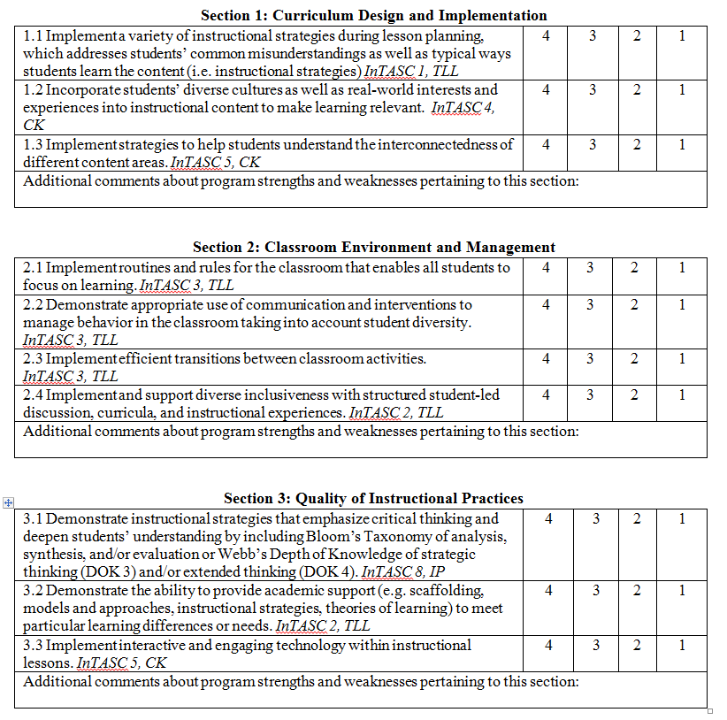
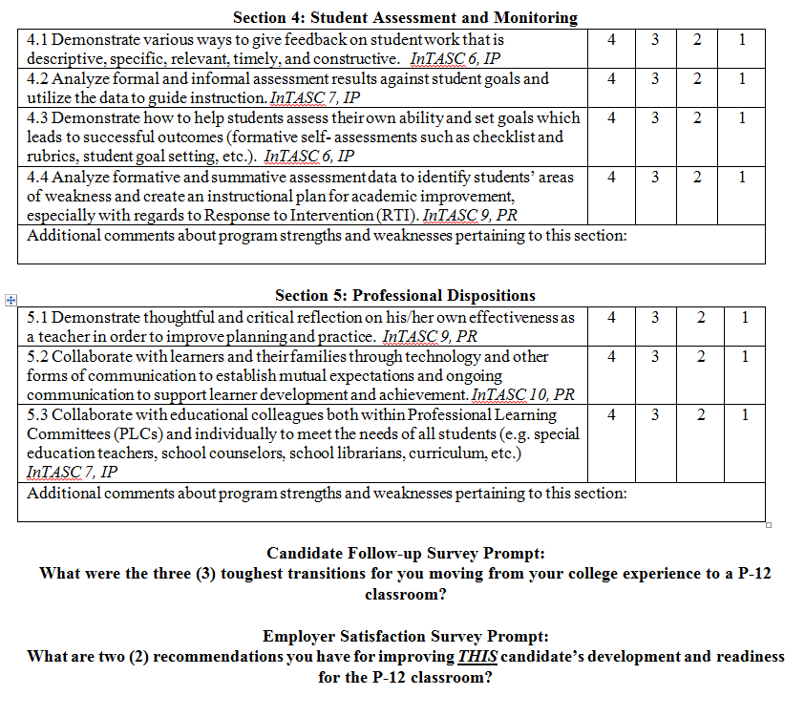
MSU Created Surveys
Notes:
4-well-prepared; 3- sufficiently prepared; 2- not sufficiently prepared; 1- not at all prepared
Benchmark is a 3.
5 sections that match the MSU FEE. 4 sections that match Compass evaluation (exclusion of professional dispositions)
Candidate Follow-up Survey Prompt:
What were the three (3) toughest transitions for you moving from your college experience to a P-12 classroom?
Employer Satisfaction Survey Prompt:
What are two (2) recommendations you have for improving THIS candidate’s development and readiness for the P-12 classroom?

Slide 27
MSU Created Survey:
Employer Satisfaction (ESS)
By the Numbers
Undergraduate
  InTASC standards and cross-cutting themes (technology/diversity) had mean range scores of 3.75 and 3.61, respectively, scoring at the ‘well-prepared’ level.
  The lowest score earned by the undergraduate completers by their employers was a mean score of 3.5 for InTASC standard 2.
PBC
  InTASC standards and cross-cutting themes (technology/diversity) had means range scores of 4.0, ‘well-prepared’ level.
Overall return rates:
Spring 2018 Completers: 4%
Fall 2018
Completers: 26%
Notes:
Employer Satisfaction Survey
For both iterations of the ESS, overall undergraduate employers indicated their satisfaction with the EPP completers as measured by ‘well prepared’ mean scores on each InTASC standard as well as the cross-cutting themes of technology and diversity with mean range scores of 3.5-4.0. A mean score of 3.5 for spring 2018 concerning InTASC Standard 2 was the lowest rated score. Undergraduate completers in English (n=1) had a rating of 2.5 for ‘not sufficiently prepared’.
For both iterations of the ESS, overall PBC employers indicated their satisfaction with the EPP completers as measured by ‘well prepared’ mean scores on each InTASC standards as well as the cross-cutting themes of technology and diversity.

Slide 28
MSU Created Survey:
Employer Satisfaction
In their own words…
Two recommendations for this completers:
Spring 2018 Completers:
  Classroom Environment and Management (40%)
  Curriculum Design and Implementation (20%)
  Student Assessment and Monitoring (13%)
  Quality of Instructional Practices (13%)
  Professional Dispositions (13%)
Fall 2018 Completers:
  Student Assessment (50%)
  Curriculum Design and Implementation (25%)
  Classroom Environment and Management (25%)
Notes:
When aggregating the answers within the portion of the ESS where employers list two recommendations specific to spring and fall 2018 completers, only Curriculum Design and Implementation was listed consistently as the second place at (20% and 25%, respectively). Classroom Environment and Management was listed as the most recommended for spring 2018 completers at 40% but only 25% for fall 218 completers. Student assessment was listed at the top recommendation for Fall 2018 completers at (50%).

Slide 29
Quotes from 2018
Employer Satisfaction Surveys
Demonstrates a high level of creativity for motivating her students (ECHD PBC)
Very resourceful and shows willingness to incorporate more strategies as she progresses (ELEM BS)
I have no recommendations for this candidate at this time. I just did her first Compass observation and I was very pleased with her performance (ECHD BS)
Her strength is in communicating with her English team in order to better her practices in the classroom (ENGL BA)

Slide 30
Employer Satisfaction Survey Conclusions
InTASC standards 1-10 show candidates scored at ‘sufficiently prepared’ for both semesters and undergraduate and alternative certification programs with mean scores of 3.5-4.0.
Secondary English (n=1) showed consistent scoring at the ‘not sufficiently prepared’ level for multiple InTASC standards.
For both Spring and Fall 2018, employers listed Curriculum Design and Implementation in the top two recommendations at 20% and 25%, respectively

Slide 31
Employer Satisfaction
Next Steps
The assessment course has been rewritten and aligned with the Senior Year Residency Performance Portfolio.
The Teaching Cycle which includes analysis of student summative data and student work samples is required for all methods courses.
A curriculum design/lesson planning course has been added to all initial certification programs
Repeatedly low participation has led the EPP to partner with Skyfactor to support creating and sending a survey using more modern technology applications. The EPP hopes that this will engage more participants and will also help with data collection and analysis of findings.

Slide 32
MSU Created Survey:
Completer Follow-up (CFS)
By the Numbers
Undergraduate and PBC
  InTASC standards 1-10 had range scores of 3.0-4.0 for both semesters meaning all completers (n=10) scored at ‘sufficiently prepared’ or ‘well prepared’.
  The lowest mean score of 2.5 was noted for the Social Studies undergraduate program (n=2) for InTASC Standard 1.
Overall return rates:
Spring 2018 completers: 9%
Fall 2018 Completers: 22%
Notes:
Completer Follow-up Survey
InTASC standards 1-10 had range scores of 3.0-4.0 for both semesters scoring overall mean scores for all programs at the ‘sufficiently prepared’ or ‘well prepared’ levels.
Although overall undergraduate scores indicated satisfaction with their preparation, only Standard 1 with a mean score of 2.5 (n=2) was scored low in Social Studies undergraduate program according to Fall 2018 respondents.
For both iterations of the CFS, mean scores were calculated at the ‘well prepared’ level (3.5-4.0) for all programs for the following InTASC Standards: Standard 4, 7, and 9.

Slide 33
MSU Created Survey:
Completer Follow-up
In their own words…
What are your toughest transitions from college to the classroom?
Spring 2018 Completers:
  Classroom Environment and Management (44%)
  Professional Dispositions (33%)
  Curriculum and Design and Implementation (22%)
Fall 2018 Completers:
  Classroom Environment and Management (44%)
  Curriculum Design and Implementation (17%)
  Student Assessment and Monitoring (17%)
  Professional Dispositions (17%)
  Quality of Instructional Practices (6%)
Notes:
When aggregating the answers within the open-ended portion of the CFS where completers list two of their toughest transitions moving from college to the classroom, spring and fall 2018 completers listed Classroom Environment and Management (44% and 44%, respectively) as their top choice. Spring 2018 completers then had Professional Dispositions (33%) listed as their second choice. Fall 2018 completers had multiple transitions with the same score of 17% which were: Curriculum Design and Implementation, Student Assessment and Monitoring, and Professional Dispositions.

Slide 34
Quotes from 2018
Completer Follow-up Surveys
Classroom management has been something I have been struggling with, but I don't think it was because I was not sufficiently prepared. I came in during the middle of the school year after several other subs had already been filtering through before me as well. I think all of this contributes some of the chaos that happens in my classroom and why the students are harder to manage. (BS Business)
I believe most of a teacher candidate experience comes from within the classroom. I have learned majority of my knowledge, techniques, management, etc from being in the classroom and working with both students and colleagues. Seeing how a classroom functions and is managed helped me to become a better teacher. Being able to observe and monitor in different schools and classrooms, I was able to see different levels of learning and how to monitor different assessments. (BS Early Childhood)

Slide 35
Completer Follow-up Survey Conclusions and Next Steps
CFS data indicates no trends can be established as each survey iteration shows strengths and challenges within the individual programs offered by the EPP (undergraduate, MAT, PBC).
Repeatedly low participation has led the EPP to partner with Skyfactor to support creating and sending a survey using more modern technology applications. The EPP hopes that this will engage more participants and will also help with data collection and analysis of findings.

Slide 36
Employer Satisfaction Survey and Completer Follow-up Survey
Comparison
InTASC | Completer Follow-up | Employer Satisfaction | Difference
Baccalaureate | 3.56 | 3.68 | .12
Alternative Certification | 3.82 | 4.0 | .18
Combined results for both CFS and ESS administered for spring and fall 2018 indicated that employers rated completer abilities higher than our graduates by .12 for baccalaureate program completers and .18 for alternative certification program completers.

Slide 37
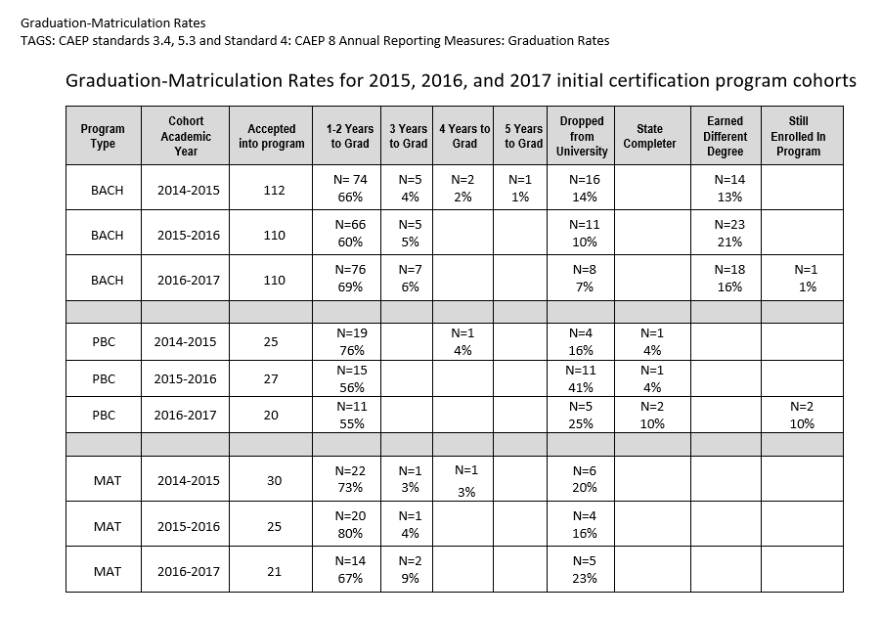
MSU Institutional Research Office
Graduation/Matriculation Rates
Notes:
Graduation/Matriculation Rates
Initial-Certification Programs
One measure of the effectiveness of an EPP is the matriculation of the candidates from acceptance into an initial certification program through graduation. When examining graduation data specific to matriculation rates for entering EPP candidates from the 2015, 2016, and 2017 cohorts, the following was noted: the majority of BACH completers finish their program within 1-2 years of officially being accepted within the EPP initial certification program (graduation rates at 66%, 60%, and 69% respectively); data shows that PBC and MAT completers finishing within 1-2 years after officially entering their programs differ according to cohort. The 2015 PBC cohort had the highest completion rate at 76% followed by 56% and 55% for the 2016 and 2017 cohorts, respectively. There is no trend data available for the MAT cohort graduates from 2015-2017 according to completion within 1-2 years of acceptance as data shows 73%, 80%, and 67% completion rates, respectively.
There was concern over the 41% (n=11) for PBC 2016 cohort that dropped from the university. After review of our records, 27% (n=3) never earned their teaching certificate, 36% (n=4) went through iTeach, 10% (n=1) earned another degree not in education, and 27% (n=3) failed out of the program.

Slide 38
Graduation/Matriculation Rates
Initial-certification Programs
Next Steps
During summer 2019, all PBC and MAT coursework will be redesigned to become online programs. Many of our candidates are working as classroom teachers and travel from long distances to attend face-to-face classes. This should alleviate the time constraints of working a full-time job and attending night classes several times a week.
We have added pre-selected videos as part of the field experience requirements that are aligned to course assignments and standards to support candidates having less time away from their full-time teaching assignments.
We have also added Praxis workshops, created by faculty who are experts in the content. This extra support is for those candidates that cannot progress in the program without passage of Praxis I or II.
Notes:
Graduation/Matriculation Rates
Initial-Certification Programs
Next Steps

Slide 39
Teach Louisiana:
Licensure and Employment Rates
(Initial Certification Programs)
Undergraduate
Year | Number of graduates | Percentage that began teaching year immediately | Percentage that was granted state license
2014-15 | 81 | 82% (n=66) | 99% (n=80)
2015-16 | 85 | 79% (n=67) | 97% (n=82)
2016-17 | 87 | 56% (n=49) | 97% (n=84)
Alternative Certification
Year | Number of graduates | Percentage that began teaching year immediately | Percentage that was granted state license
2014-15 | 40 | 78% (n=31) | 100%
2015-16 | 38 | 76% (n=29) | 97% (n=37)
2016-17 | 39 | 82% (n=32) | 97% (n=38)
Notes:
Licensure Rates for
Initial-certification Programs
MSU EPP completers have a consistently high rate of receiving their state teaching licenses. An EPP requirement for each of the initial certification programs is that candidates must complete all licensure exams before beginning their student teaching/internship semesters. This program requirement means that once candidates have completed their student teaching/internship semesters, they have fulfilled all state requirements for licensing. For the three cycles of data collected, completers of all EPP initial-certification programs had a state licensure rate of 97% or higher over the last three years. The data shows that over the course of three cycles, with all three programs accounted for, only nine (9) completers out of a total of 371 did not submit their paperwork to become a licensed teacher in the state of Louisiana.
Employment Rates for
Initial-certification Programs
Although licensure rates for all three programs are very high, employment rates for the licensed completers are much lower. Employment rates included with the LBoR Data Dashboard and Factbook take into account only the completers who gain employment within the state of Louisiana and in a public P-12 setting. If a completer gained employment outside of the state or within private daycare or non-public P-12 school settings including charter schools, then the EPP does not get credit for that employment. Using the data from the LBoR Data Dashboard, the lowest percentages of completers gaining employment within public school systems in the state of Louisiana came during our 2017 cohort for undergraduate and the 2016 cohort for alternative certification programs. The fluctuation of percentages in between the three cohorts does not indicate any patterns or trends for the alternative certification programs; however, a decline in percentage of graduates that begin teaching immediately has occurred every year.

Slide 40
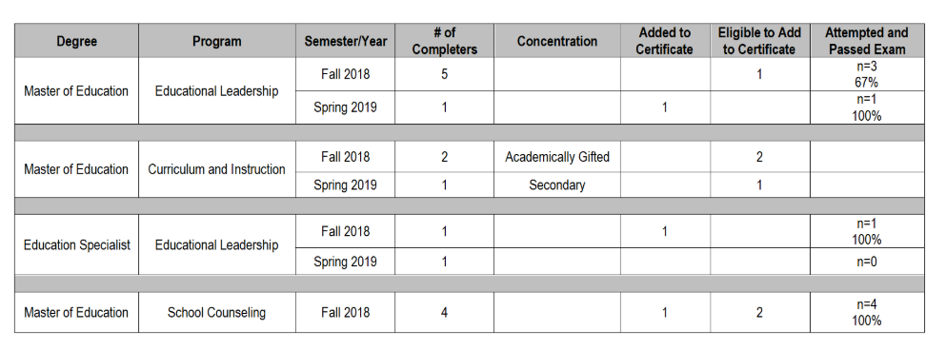
Teach Louisiana:
Graduation and Licensure Rates
Advanced Programs
Notes:
Graduation and Licensure Rates
Advanced Programs
Advanced programs for the 2018-19 academic year have low enrollment. Master of Education in Educational Leadership had 6 completers, the Master of Education in Curriculum and Instruction had 3 completers, the Educational Specialist in Educational Leadership had 2 completers, and the Master of Education in School Counseling had 4 completers. Twenty percent (20%) of completers added their new certification area to their Louisiana teaching license. Specific to the Master of Education in Educational Leadership: EDLD candidates cannot add an EDLD certification to their teaching license until they are hired by a district in the official capacity of an Educational Leader. They are only ‘eligible’ to hold the license.

Slide 41
Graduation and Licensure Rates
Advanced Programs
Next Steps
Newly redesigned Master of Education in Curriculum and Instructions programs in place for 2020-2021
Continue the Mentor Teacher Training pathways for 2020-2021:
  Professional Development
  Embedded in the Master of Education programs
Notes:
Graduation and Licensure Rates
Advanced Programs
Next Steps

Slide 42
United States Department of Education:
MSU Loan Default Rates
Fiscal Year | 2016 | 2015 | 2014 | 2013
Default rate | 13.6% | 9.9% | 11% | 12.4%
# in default | 227 | 178 | 195 | 224
# in repayment | 1.662 | 1,795 | 1,758 | 1,805
National cohort default rate | 10.1% | 10.8%
Notes:
Cohort Default Rates
MSU cohort default rates for the enrollment years of 2013-2016 are as follows: 12.4%, 11%, 9.9%, and 13.6% respectively. The reported cohort default rates are for all students enrolled in MSU, not just those specific to the EPP. The national cohort default rate for the 2016 fiscal year was 10.1%. The conclusions from this data are that the default rates of MSU students have had a steady decline over during 2013-2015. MSU had a default rate of almost less than 1% of the national average for the 2015 reporting period; however, for the 2016 reporting period, MSU is 2.5% higher than the national default rate average.
Information retrieved from National Center for Education Statistics athttps://nces.ed.gov/collegenavigator/?q=mcneese+state+university&s=all&id=159717#fedloans
Information retrieved from Federal Student Aid website at https://www2.ed.gov/offices/OSFAP/defaultmanagement/cdr.html

Slide 43
Questions??
Contact Dr. Angel Ogea, Dean of the Burton College of Education
aogea@mcneese.edu

