Slide 1
Program Scaffolding and Curriculum Maps
Dr. Jan Robichaux
Burton College of Education
January 10, 2019

Slide 2
Effective people plan with the end in mind.
-Dr. Steven Covey
Notes:
First you have to start with a clear understanding of your destination. The instructional design model that Wiggins and McTighe have created is a framework that begins with the learners goals in mind. In order for course or unit instruction to be engaging and effective instructors should start with the end in mind.
In this session we are going to use the Backward Design model as a guideline to creating a program curriculum that is purposeful in leveraging what students need to know and understand during the design process in order to progress.

Slide 3
In this session:
Creating an 8-semester plan
Collecting and utilizing data throughout the program
Sequencing standards and progression of learning throughout the program

Slide 4
Backward Design- Three Steps
Identify desired results
Determine acceptable evidence
Plan learning experiences and instruction
Notes:
Identify the desired results that you want from your learners. In other words this is your destination for your students. This is the step that as the designer/instructor, you think about what information you want your students to understand which should not be confused with what you want them to know. Results that produce student understanding will then in turn produce students that can transfer knowledge and skills into other situations.
The second step is to determine what you will gather from your students as acceptable evidence. It will be very important to make sure that when determining what this evidence will look like. Be sure to choose evidence that will align with step one which is your desired results.
The last step is to plan the learning experiences and instruction of the course or unit. Your goal in this step is to make the instruction and learning experiences engaging and effective for all students.

Slide 5
Identify Desired Results
Questions to ask during this process
What is important for my students to know AND be able to do?
What big ideas and important understandings should my students retain?
What is worthy of understanding?
Notes:
We want the learning that is going to stick with our students and be meaningful.
Ask yourself these questions and identify the results and then you will be able to weed out what is unnecessary for students to learn. Instead students will have more of a buy-in as they learn content. Students will better understand why their learning is important instead of giving the typical responses of I just needed to know it for the test.

Slide 6
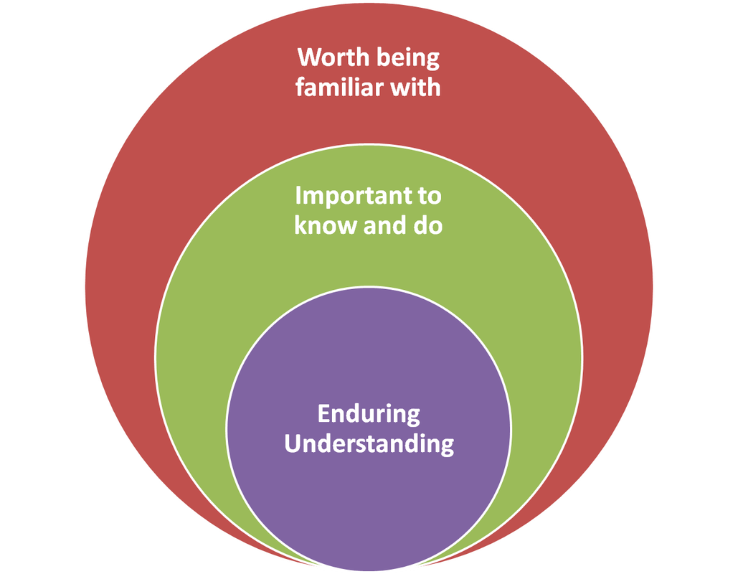
Establishing Curricular Priorities
Broad Knowledge (read, review, encounter)
Important Knowledge and Skills
(facts, concepts, strategies, processes, methods)
What should they retain after many details are forgotten?
(application and transfer of knowledge)
Notes:
It can be difficult to prioritize and narrow down content to teach.
In order for the content to fit within the framework of your course or unit Wiggins and McTighe provide a useful process for establishing priorities in your curriculum.
Too much content and not enough time to teach effectively.
Helpful way to sort and prioritize the content in a course, unit, or program.
Help focus on the big ideas or essential learning for the program/course/etc.
Think about different levels of knowledge and understand that not every concept has the same degree or level of importance.
The smaller circle represents the essential learning that we want to take place. This is where students will be able to transfer and apply knowledge.
Each circle is important but in order for learners to take away meaning from their learning, designers need to identify the enduring idea (what will students remember years down the road).

Slide 7
Standards
Council for the Accreditation of Educator Preparation
Interstate New Teacher Assessment and Support Consortium (InTASC)
Louisiana Components of Effective Teaching
Louisiana Teacher Competencies
Specialized Professional Associations (SPA) Standards

Slide 8
Long-Term Transfer Goal
“Students will be able to independently use their learning to…”
An effective curriculum equips learners for autonomous performance… by design!

Slide 9
Determining Acceptable Evidence
Think “Photo Album” versus “Snapshot”
Sound assessment requires multiple sources of evidence, collected over time
Gather evidence from a Range of Assessments
Authentic tasks and projects
Academic exam questions, prompts, and problems
Quizzes and test items
Informal checks for understanding
Student self-assessments

Slide 10
Determining Acceptable Evidence
How will you know if your students have reached the desired results?
Oral questions
Observations
Informal Dialogue
Quizzes
Performance Tasks/Projects
Open-ended Prompts
Notes:
How will you know if your students have reached the desired results?
In backward design, thinking like as assessor should come before designing the actual less, unit, or course.
Evidence of understanding can be collected in many ways and a collection of evidence should take place over time instead of a single moment in time which is often a test that is given at the end of a course or the end of a program (Capstone).
As yourself
What evidence do I need?
What characteristics are being examined in student responses in products when
Does the evidence align with step one of the design model?

Slide 11
Most Difficult Item on New York State Tenth-Grade Math Test
A straw is placed into a rectangular box that is 3 inches by 4 inches by 8 inches as shown in the accompanying diagram. If the straw fits exactly into the box diagonally from the bottom left front corner to the top right back corner, how long is the straw to the nearest tenth of an inch?
WHY?
-Lack of cues
-Failure to transfer
-Do they really understand?
Fewer than 30% of all tenth graders answered this correctly, even though the Pythagorean theorem is routinely taught.
8
4
3

Slide 12
Planning Process
Understanding requires active meaning-making by the learner
The content is learned as a means to answer questions and to help solve problems

Slide 13
Planning Process
Essential Questions for Planning Instruction and Learning Experiences
What do learners need, given the desired results?
What is the best use of time spent in and out of the classroom, given the performance goals?
GOOD PLANNING = ENGAGING + EFFECTIVE
Notes:
Appropriate learning activities are determined through the planning process.
I hear I forget, I see I remember I do I understand.
During step three of this model, learners should walk away with an understanding of content.
Planned activities are successful when students can transfer their understanding of the content to new situations.
Here are a few questions to consider when planning for instruction. During the final steps designers should ask the question, given the desired results in targeted performance, what kinds of instructional approaches, resources, and experiences are required to achieve these goals?
Good planning will be both engaging and effective.
When learners are engaged they will be pulled deeper into the subject content, therefore becoming a part of the challenges and demands of the tasks given.
We will know we are effective when the learning design has proven to help learners become more competent and productive at worthy work.

Slide 14
Expectations
Student Centered
Assessments and Activities May Change
Challenging and Uncomfortable
Notes:
What are some things that we can expect when using this model?
Role of the teacher will shift; Students will become the center of its instruction; Teachers will find that student questions will often lead discussions and resources that may be used. This does not mean that the teacher is no longer teaching. There will be times when teaching content is necessary, however, other times the teacher is more of a coach and will only provide information or content when necessary. Students should be given time to figure out what to do with information and how to use it.
Change within courses are lessons may occur depending on the evidence that is gathered. Just always ensure that the steps within the design model align with one another to achieve the desired results that you are looking for from the students.
Since this design focuses on big ideas, students will feel more challenged, however, with those challenges some students may become more uncomfortable. Sharing the why and the where we are headed at the beginning of the unit, course, or program will help students to become less uncomfortable.

Slide 15
Elementary Education Program Goals
Demonstrate the ability to effectively develop effective lesson and assessment plans.
Demonstrate the ability to effectively implement classroom management strategies, implement their lesson plan, and provide students with quality academic feedback.
Fully analyze student outcomes, written feedback practices, and self-assess their instructional practices

Slide 16
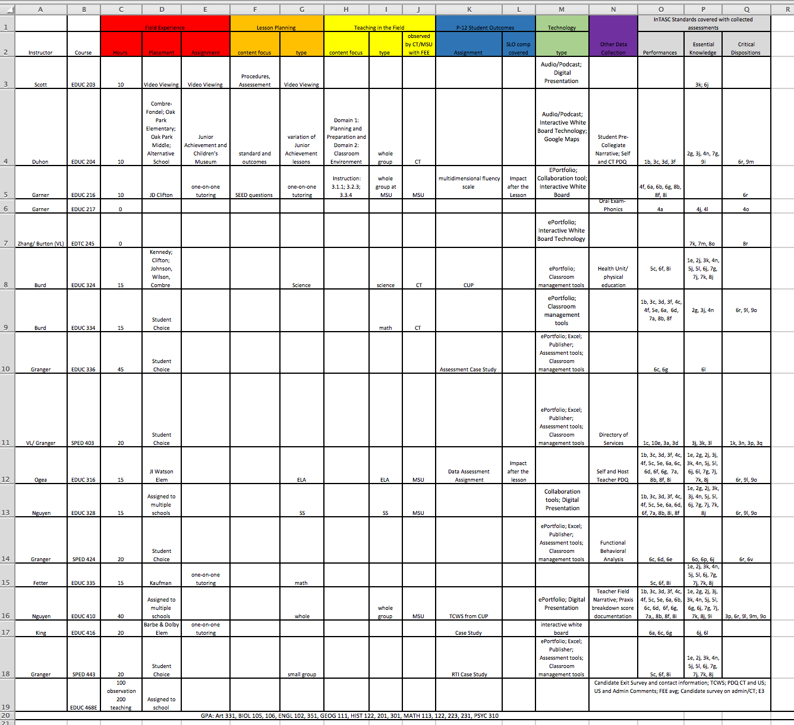
Elementary Education

Slide 17
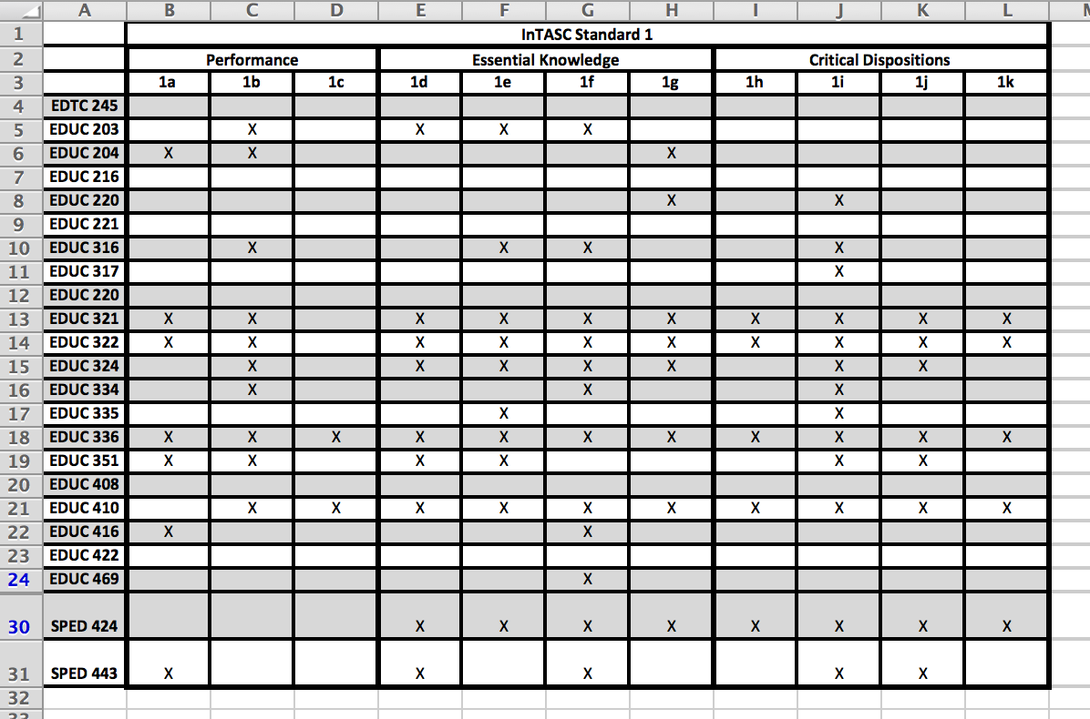
Standards and Outcomes

Slide 18
Course Sequence

