Slide 2
Purpose: create high-quality master of education programs that will support all learners and transform current educational systems that is ground in research
Goal
Ensure graduates completing our advanced level programs are well prepared to be agents of change in their designated areas
Identify
A common understanding of what an effective C&I program focuses on
Brainstorm
Learning experiences, resources, assignments, and assessments that are applicable to current educational settings

Slide 3
13.0301 Curriculum and Instruction
A program that focuses on the curriculum and related instructional processes and tools, and that may prepare individuals to serve as professional curriculum specialists. Includes instruction in curriculum theory, curriculum design and planning, instructional material design and evaluation, curriculum evaluation, and applications to specific subject matter, programs, or educational levels.

Slide 4
Our new programs
Master in Education in Curriculum and Instruction
with a concentration in:
Academically Gifted
Literacy in K-12 Education
Special Education 1-5; 6-12
English Learners
Master in Education in Educational Technology Leadership

Slide 5
Our new programs
What they will get:
Master Degree
Mentor Teacher Trained
Additional certification added to their teaching license
EDLD field hours (240 clock hours)
Publication/presentation

Slide 6
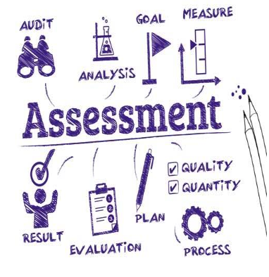
Creating an ideal program

Slide 7
What we are required to align to:
A.1.1., A.1.2., A.2.1., A.2.2.
Notes:
BESE policies/bulletins website: https://bese.louisiana.gov/policy
CAEP Advanced Standards 2-page summary doc: http://caepnet.org/~/media/Files/caep/standards/advprogramstandards-onepager-lastedit819.pdf?la=en
ISTE for educational leaders: http://npbea.org/wp-content/uploads/2017/06/Professional-Standards-for-Educational-Leaders_2015.pdf
ISTE for educators: https://www.iste.org/standards/for-educators
ISTE for students: https://www.iste.org/standards/for-students
National Association for Gifted Children: https://www.nagc.org/sites/default/files/standards/Advanced%20Standards%20in%20GT%20(2013).pdf
Council for Exceptional Children: https://www.cec.sped.org/~/media/Files/Standards/Professional%20Preparation%20Standards/Advanced%20Preparation%20Standards.pdf
NELP for EDLD aligned field experience ideas (National Policy Board for Educational Administration): http://npbea.org/wp-content/uploads/2018/11/NELP-Building-Standards.pdf
International Literacy Association: https://literacyworldwide.org/get-resources/standards/standards-2017
https://ccsso.org/sites/default/files/2017-11/Final%204_30%20ELPA21%20Standards%281%29.pdf

Slide 8
What is the purpose of today?
Review the required standards for the specific program
Brainstorm field experiences that align to concentration area and Educational Leadership hours
Process of content to be learned
Ideas for assessments that are aligned to real-world knowledge and skills currently required in the field
Volunteer to contribute something specific at the next meeting
Determine next meeting facilitated by your MSU representative for the week of April 6th
Notes:
You might have a discussion with one person taking notes to submit.
You might take individual time to think and then begin the discussion.
You might use a technology to input all ideas as a visual

Slide 9
What is the purpose of our next meeting?
Review previous brainstorming from Meeting #1 (today’s meeting)
Identify new resources, assignments, assessments, etc. brought by the group
Determine overarching Student Learning Outcomes for the program
Notes:
Next meeting we should be able to determine what it is we want our graduates to be able to know and do. (week of April 6th)
3rd meeting: align assessments/activities/experiences to SLOs and other accrediting standards (depending on our life– either in May or June)
4th meeting: determine progression of learning for students (field experiences, content, activities, assessments) (June)

